Slide 1
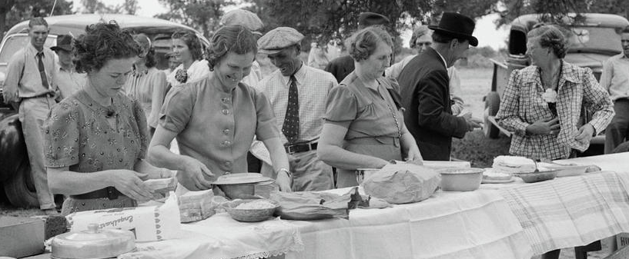
Virtual Potluck Primer
Enjoy Good Food and Let’s Share Our Favorite Recipes!

Slide 2
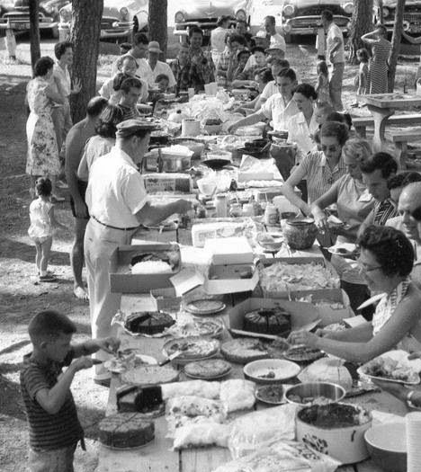
What Is A Potluck?
A potluck dinner (or Supper, or Picnic) is a social gathering where each guest brings a dish to share with the rest of the attendees. It is a great way to enjoy good food, connect with friends and family, and foster a sense of community. Potluck parties are popular for various occasions, including birthdays, holidays, and casual get-togethers. And they are also a tradition at Granges dating back to the 1800s.

Slide 3
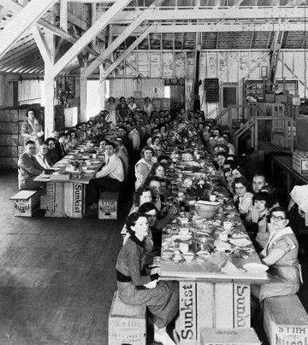
Potluck Origins
The word “potluck” is derived from the Middle English word “potlakke,” which literally means “food provided for a meal.” It later evolved to refer to the practice of sharing food in a communal setting. Over time, potlucks became a popular way for communities to gather and enjoy each other’s company while sharing a meal.

Slide 4
History of Potlucks
One of the earliest recorded instances of communal dining can be traced back to medieval Europe, where peasants would come together to celebrate harvest festivals. They would bring their own dishes and share them with the community, creating a festive atmosphere.
In North America, the tradition of potluck dinners can be traced back to the 17th and 18th centuries when settlers came together to celebrate milestones and holidays. These gatherings often involved each family bringing a dish to contribute to the meal, as resources were limited and it made sense to pool food and share the responsibilities of cooking.
During the Great Depression in the 1930s, potlucks gained even more popularity as a way for people to gather and share what little they had. It provided an opportunity for communities to come together, support one another, and enjoy a hearty meal.
Over time, potluck dinners have become more common and have adapted to modern life. They are now associated with a sense of community, cooperation, and celebration. Potlucks often occur in social settings, such as Grange gatherings, neighborhood block parties, and even office luncheons.

Slide 5
History of Potlucks
Today, potlucks are not only a way to bring people together but also an opportunity to showcase culinary skills, discover new recipes, and experience different cuisines. It is a chance for guests to contribute their favorite dishes, showcase their cultural heritage, or simply share a homemade specialty.
By bringing together a diverse array of dishes, potlucks create a unique dining experience. It allows attendees to explore different flavors, sample new dishes, and engage in conversations about food and cooking.
The evolution of potluck dinners over the years is a testament to their enduring popularity and the desire for people to connect through food.

Slide 6
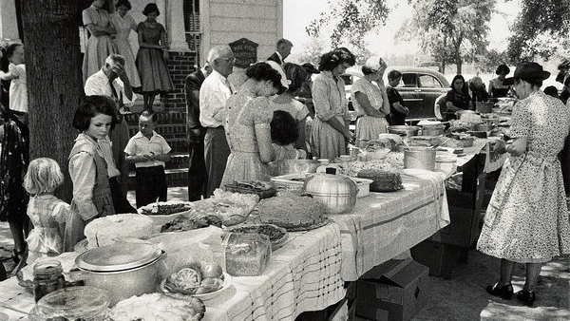

Slide 7
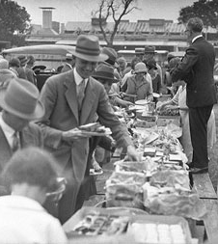
Potluck Planning
The process of organizing and executing a potluck involves several key steps.
First, as the host, you will need to decide on the date, time, and location for the event. It is essential to provide this information to your guests well in advance, allowing them enough time to plan and prepare their dishes.
Once the basic logistics are in place, you will need to coordinate the menu. This avoids duplications and ensures a diverse spread of dishes. You can suggest categories such as appetizers, main courses, side dishes, and desserts to guide their selections.

Slide 8
Potluck Planning
When it comes to the quantity of food, advise guests to prepare enough to serve a portion to accommodate everyone in attendance. This ensures that there is enough food to go around and allows the sampling of a variety of dishes.
On the day of the potluck, set up a designated area for the food to be displayed. This is often a buffet-style arrangement with tables or a counter where guests can place their dishes. You may want to provide labels or index cards to write the name of their dish and any other information.
Once all the dishes have been arranged, it is time for the guests to serve themselves. Encourage everyone to sample a little bit of everything.

Slide 9
Potluck Planning
During the meal, encourage conversation and create an inviting atmosphere. Provide ample seating space and arrange the tables in a way that facilitates interaction among the attendees. This will foster a sense of community and enjoyment as everyone indulges in the delicious feast.
Lastly, the cleanup process. Clear communication about cleanup expectations will help prevent any confusion or misunderstandings.

Slide 10
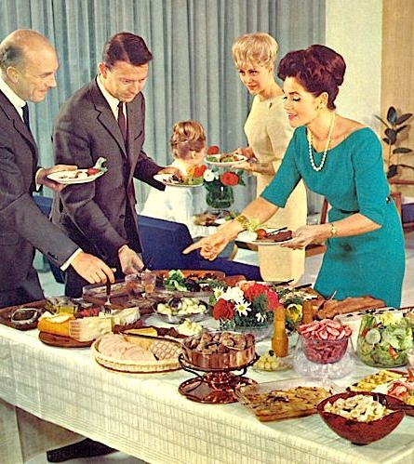
Potluck Benefits
Hosting a potluck comes with a wide array of benefits that make it a delightful and rewarding experience.
Variety of Dishes
Shared Responsibility
Social Connection and Fellowship
Cultural Exchange
Showcasing of Culinary Skills
Welcoming Environment

Slide 11
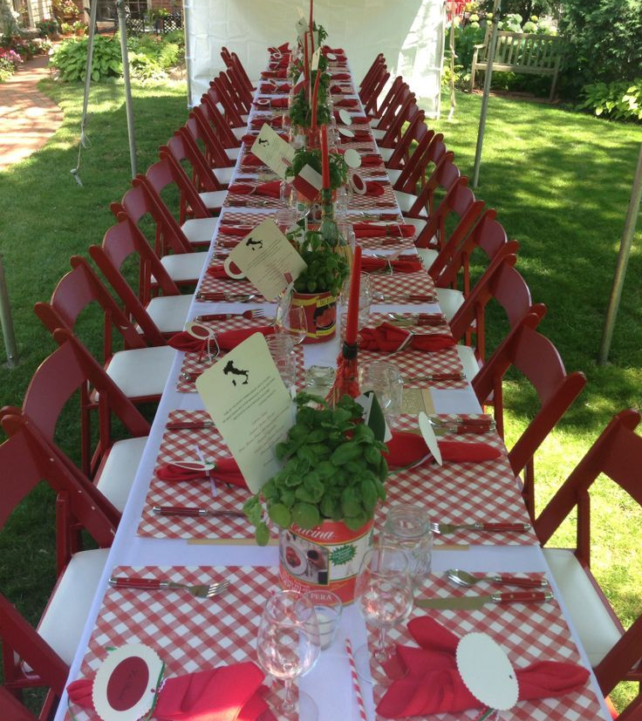
Potluck Ideas
Adding a theme to the next Grange potluck can take the event to a new level, creating excitement and encouraging creativity among guests.
Here are some ideas to inspire:
International Cuisine: Choose a specific country or region and ask guests to bring dishes that represent that cuisine. It’s a great way to explore different flavors and cultural traditions. And be sure to set the tables to reflect the theme too.
Around the World: Have guests bring dishes from various countries around the world. It creates a global culinary experience with a diverse range of flavors.

Slide 12
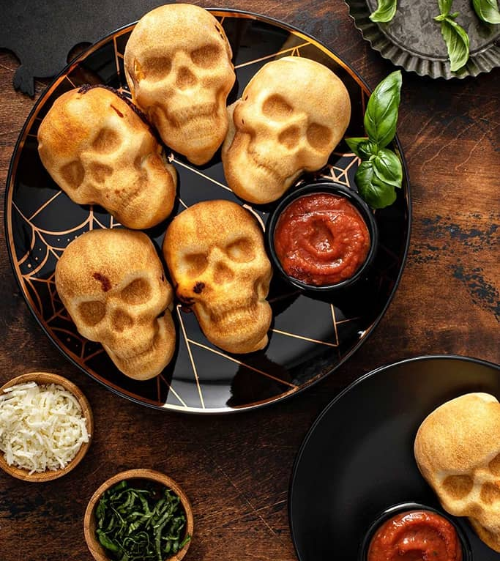
Potluck Ideas
Festive Holiday: If your potluck dinner party aligns with a specific holiday, such as Christmas, Easter, Thanksgiving, or Halloween, ask guests to bring dishes that are traditionally associated with that occasion. It adds a festive touch to the event.

Slide 13
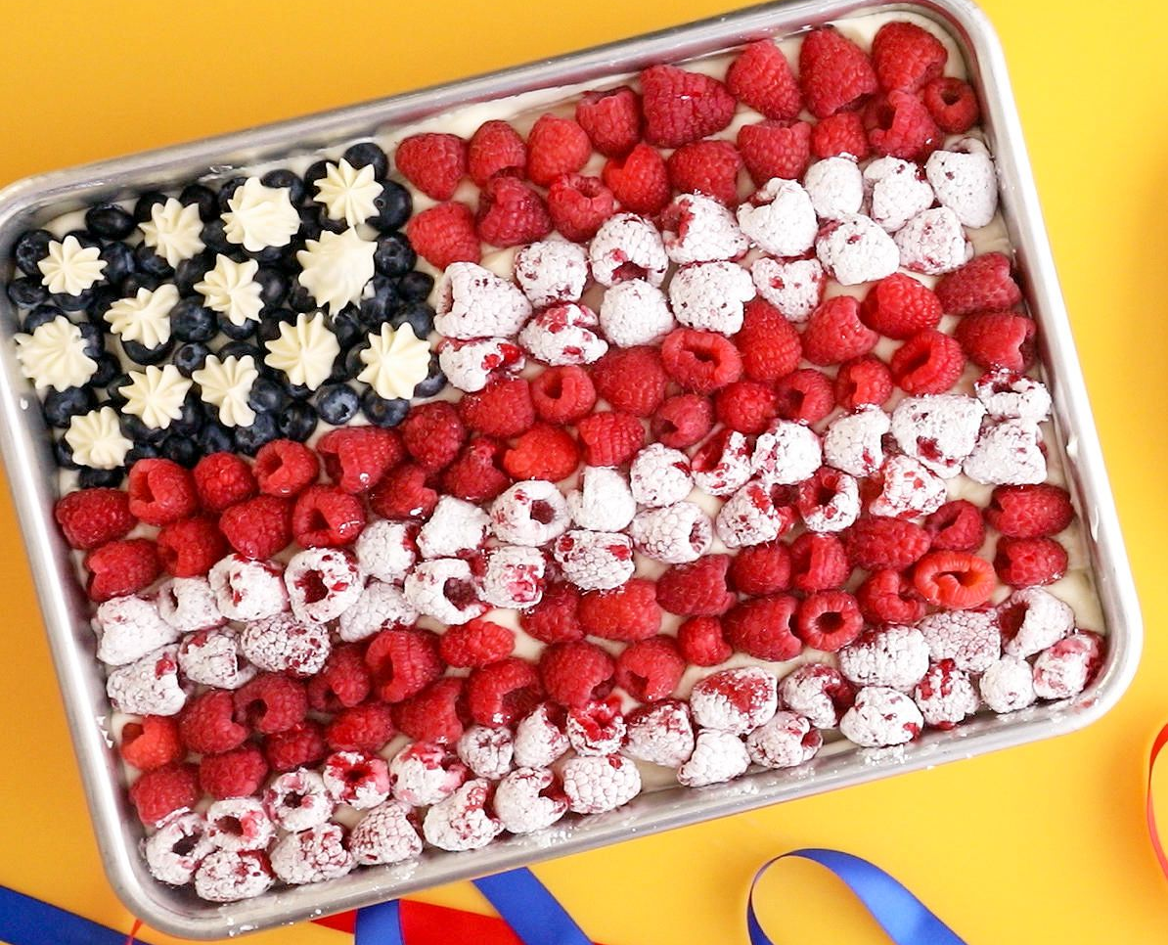
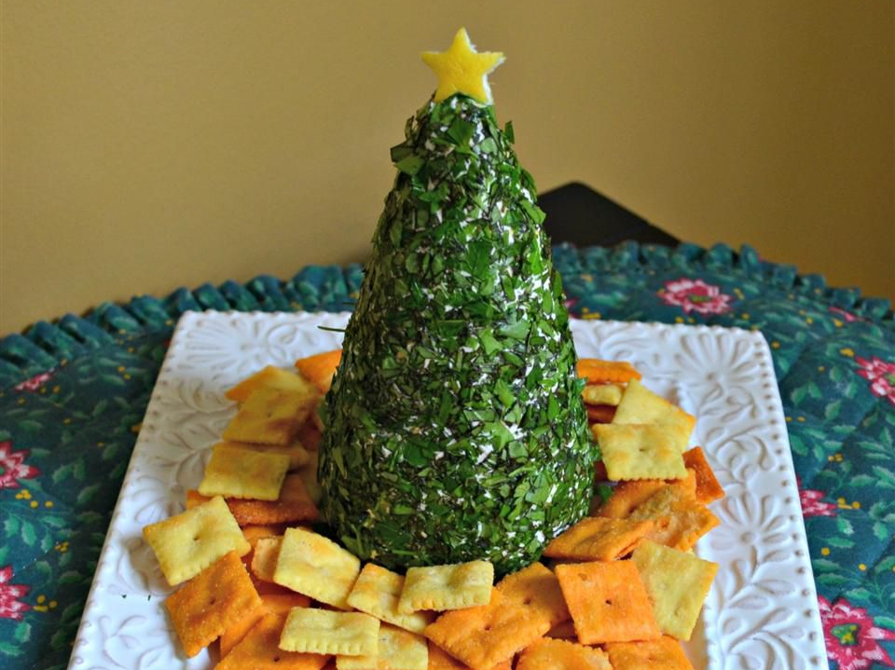
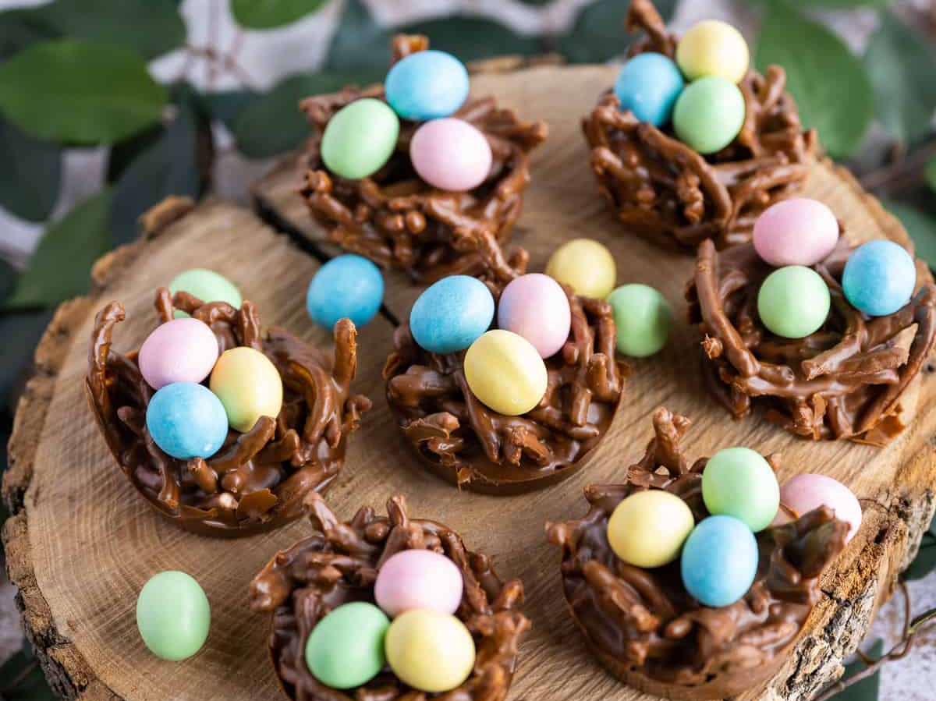

Slide 14
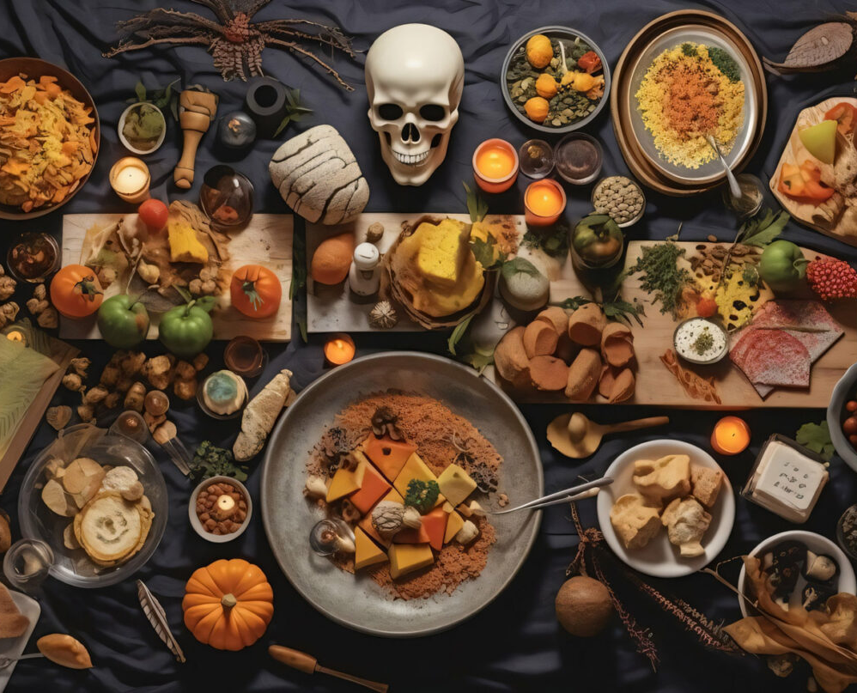
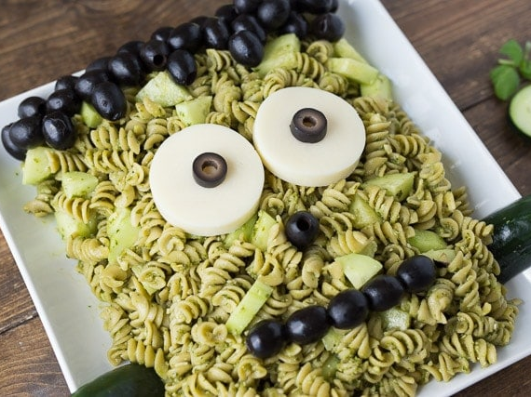
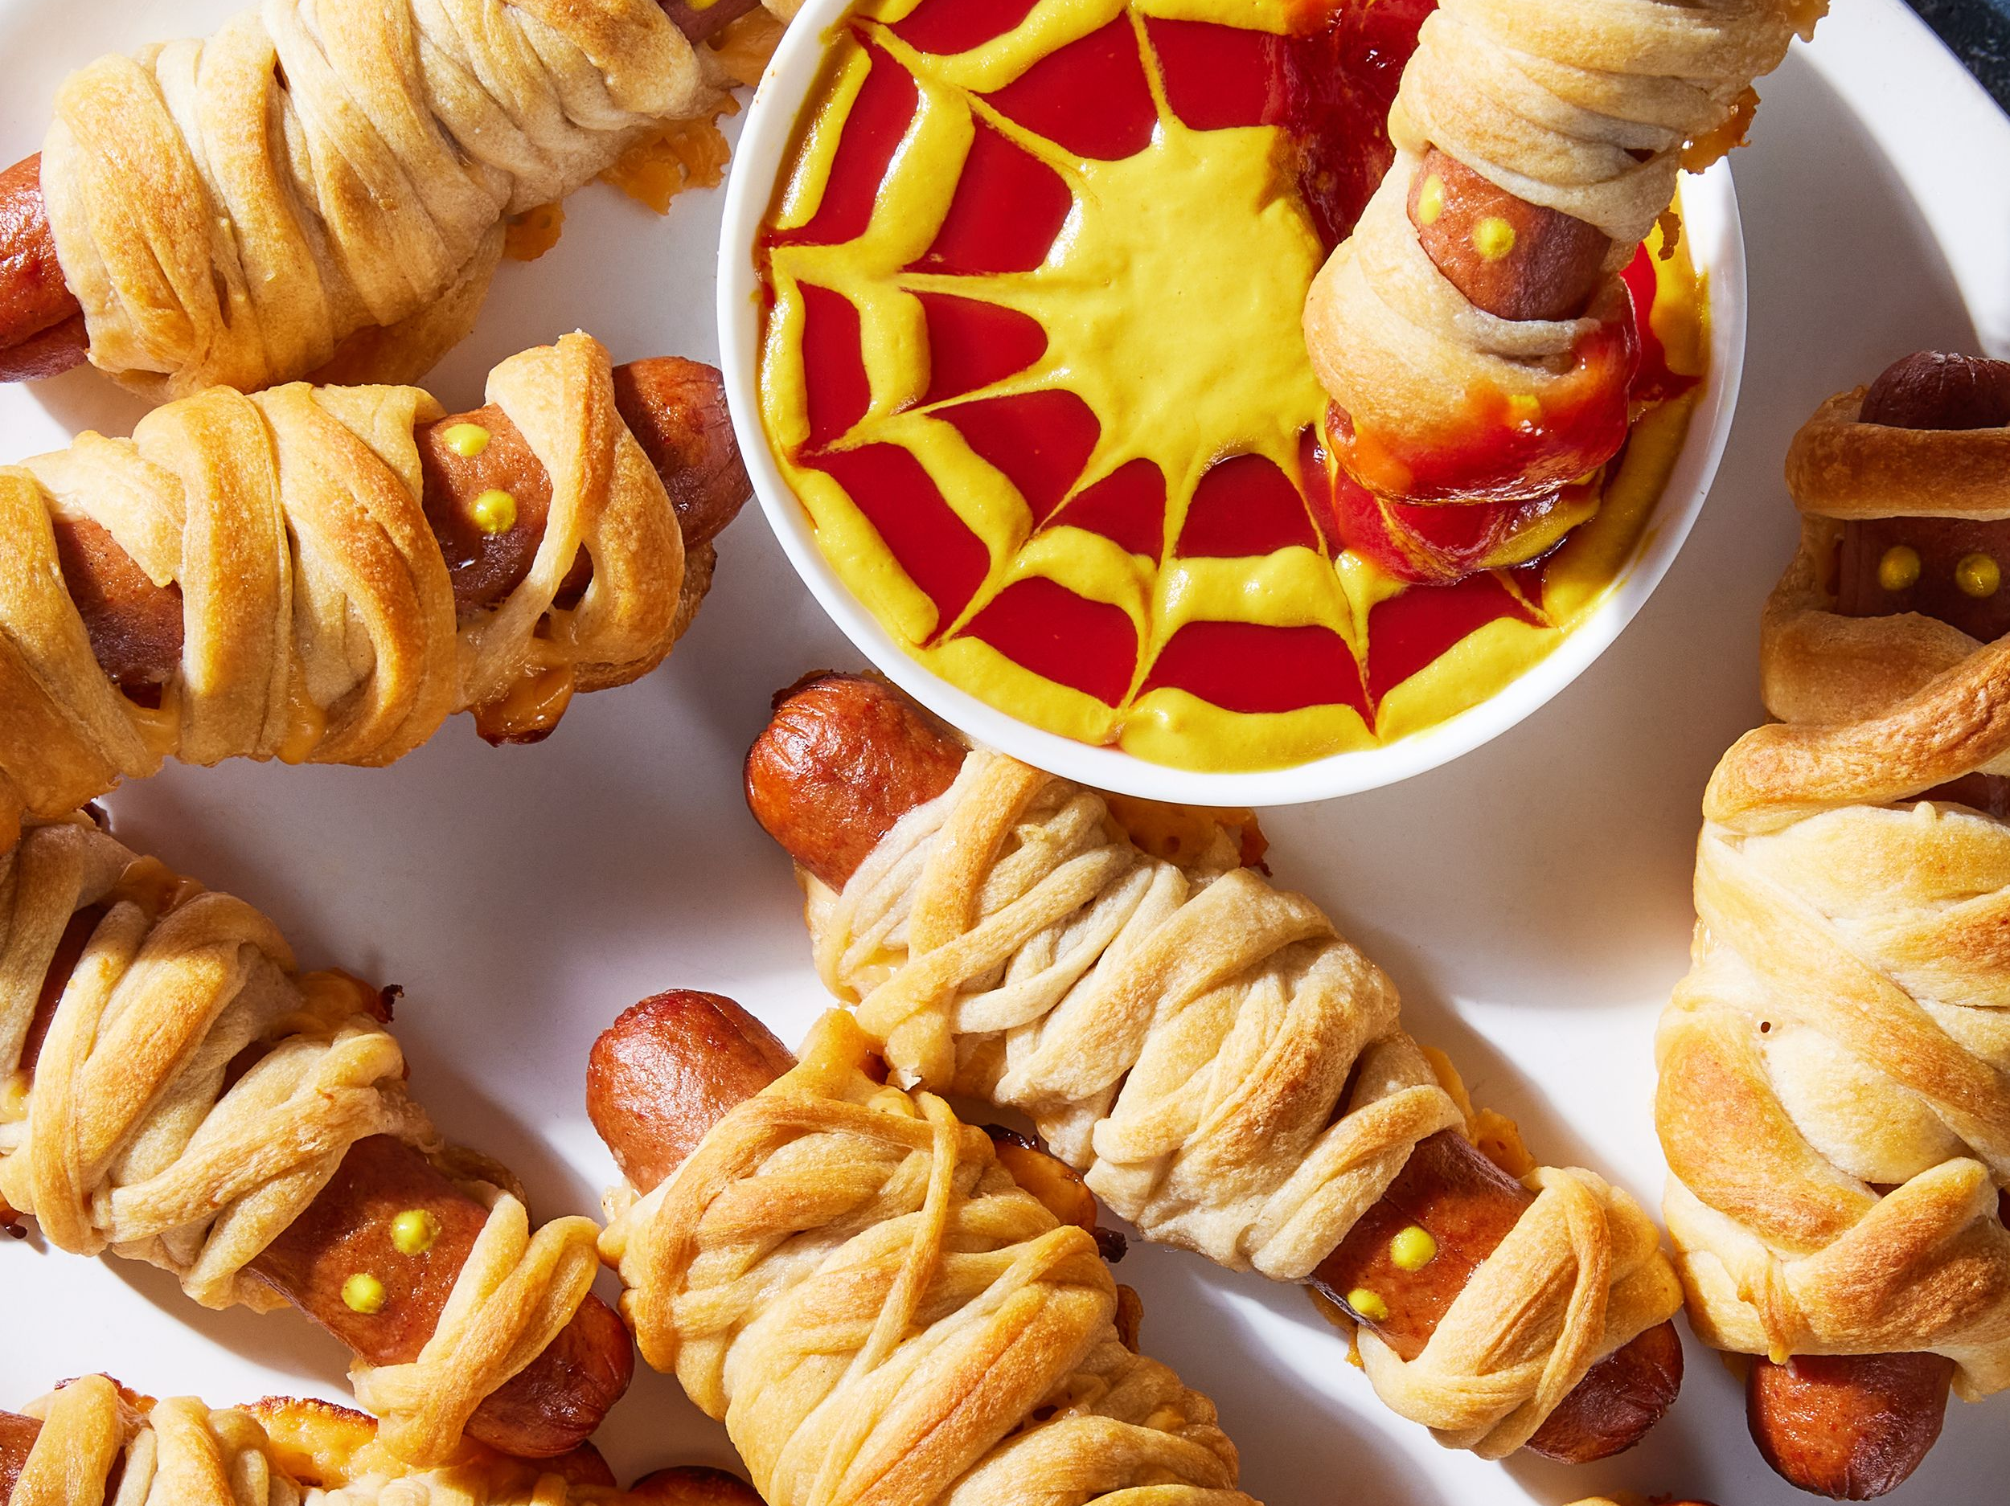

Slide 15
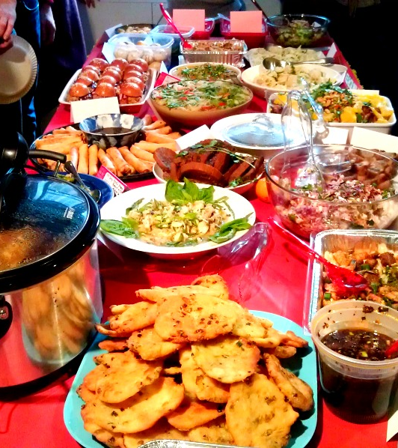
Potluck Ideas
Comfort Food: Set a theme focused on comfort foods, such as macaroni and cheese, mashed potatoes, summertime salads, or even pot pies. Guests can bring their own unique versions of their favorite comfort dishes.

Slide 16
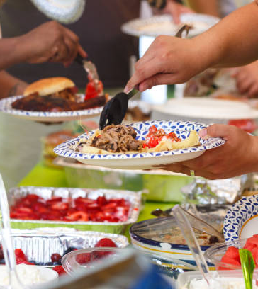
Potluck Ideas
Potluck Picnic: Take your potluck outdoors and ask guests to bring dishes suitable for a picnic. Think sandwiches, salads, finger foods, and refreshing beverages.
Outdoor BBQ: If weather permits, host a potluck with a BBQ theme. Guests can bring their grilling specialties, such as marinated meats, pulled pork, hotdogs and toppings, grilled vegetables, baked beans, and delicious BBQ sauces.

Slide 17
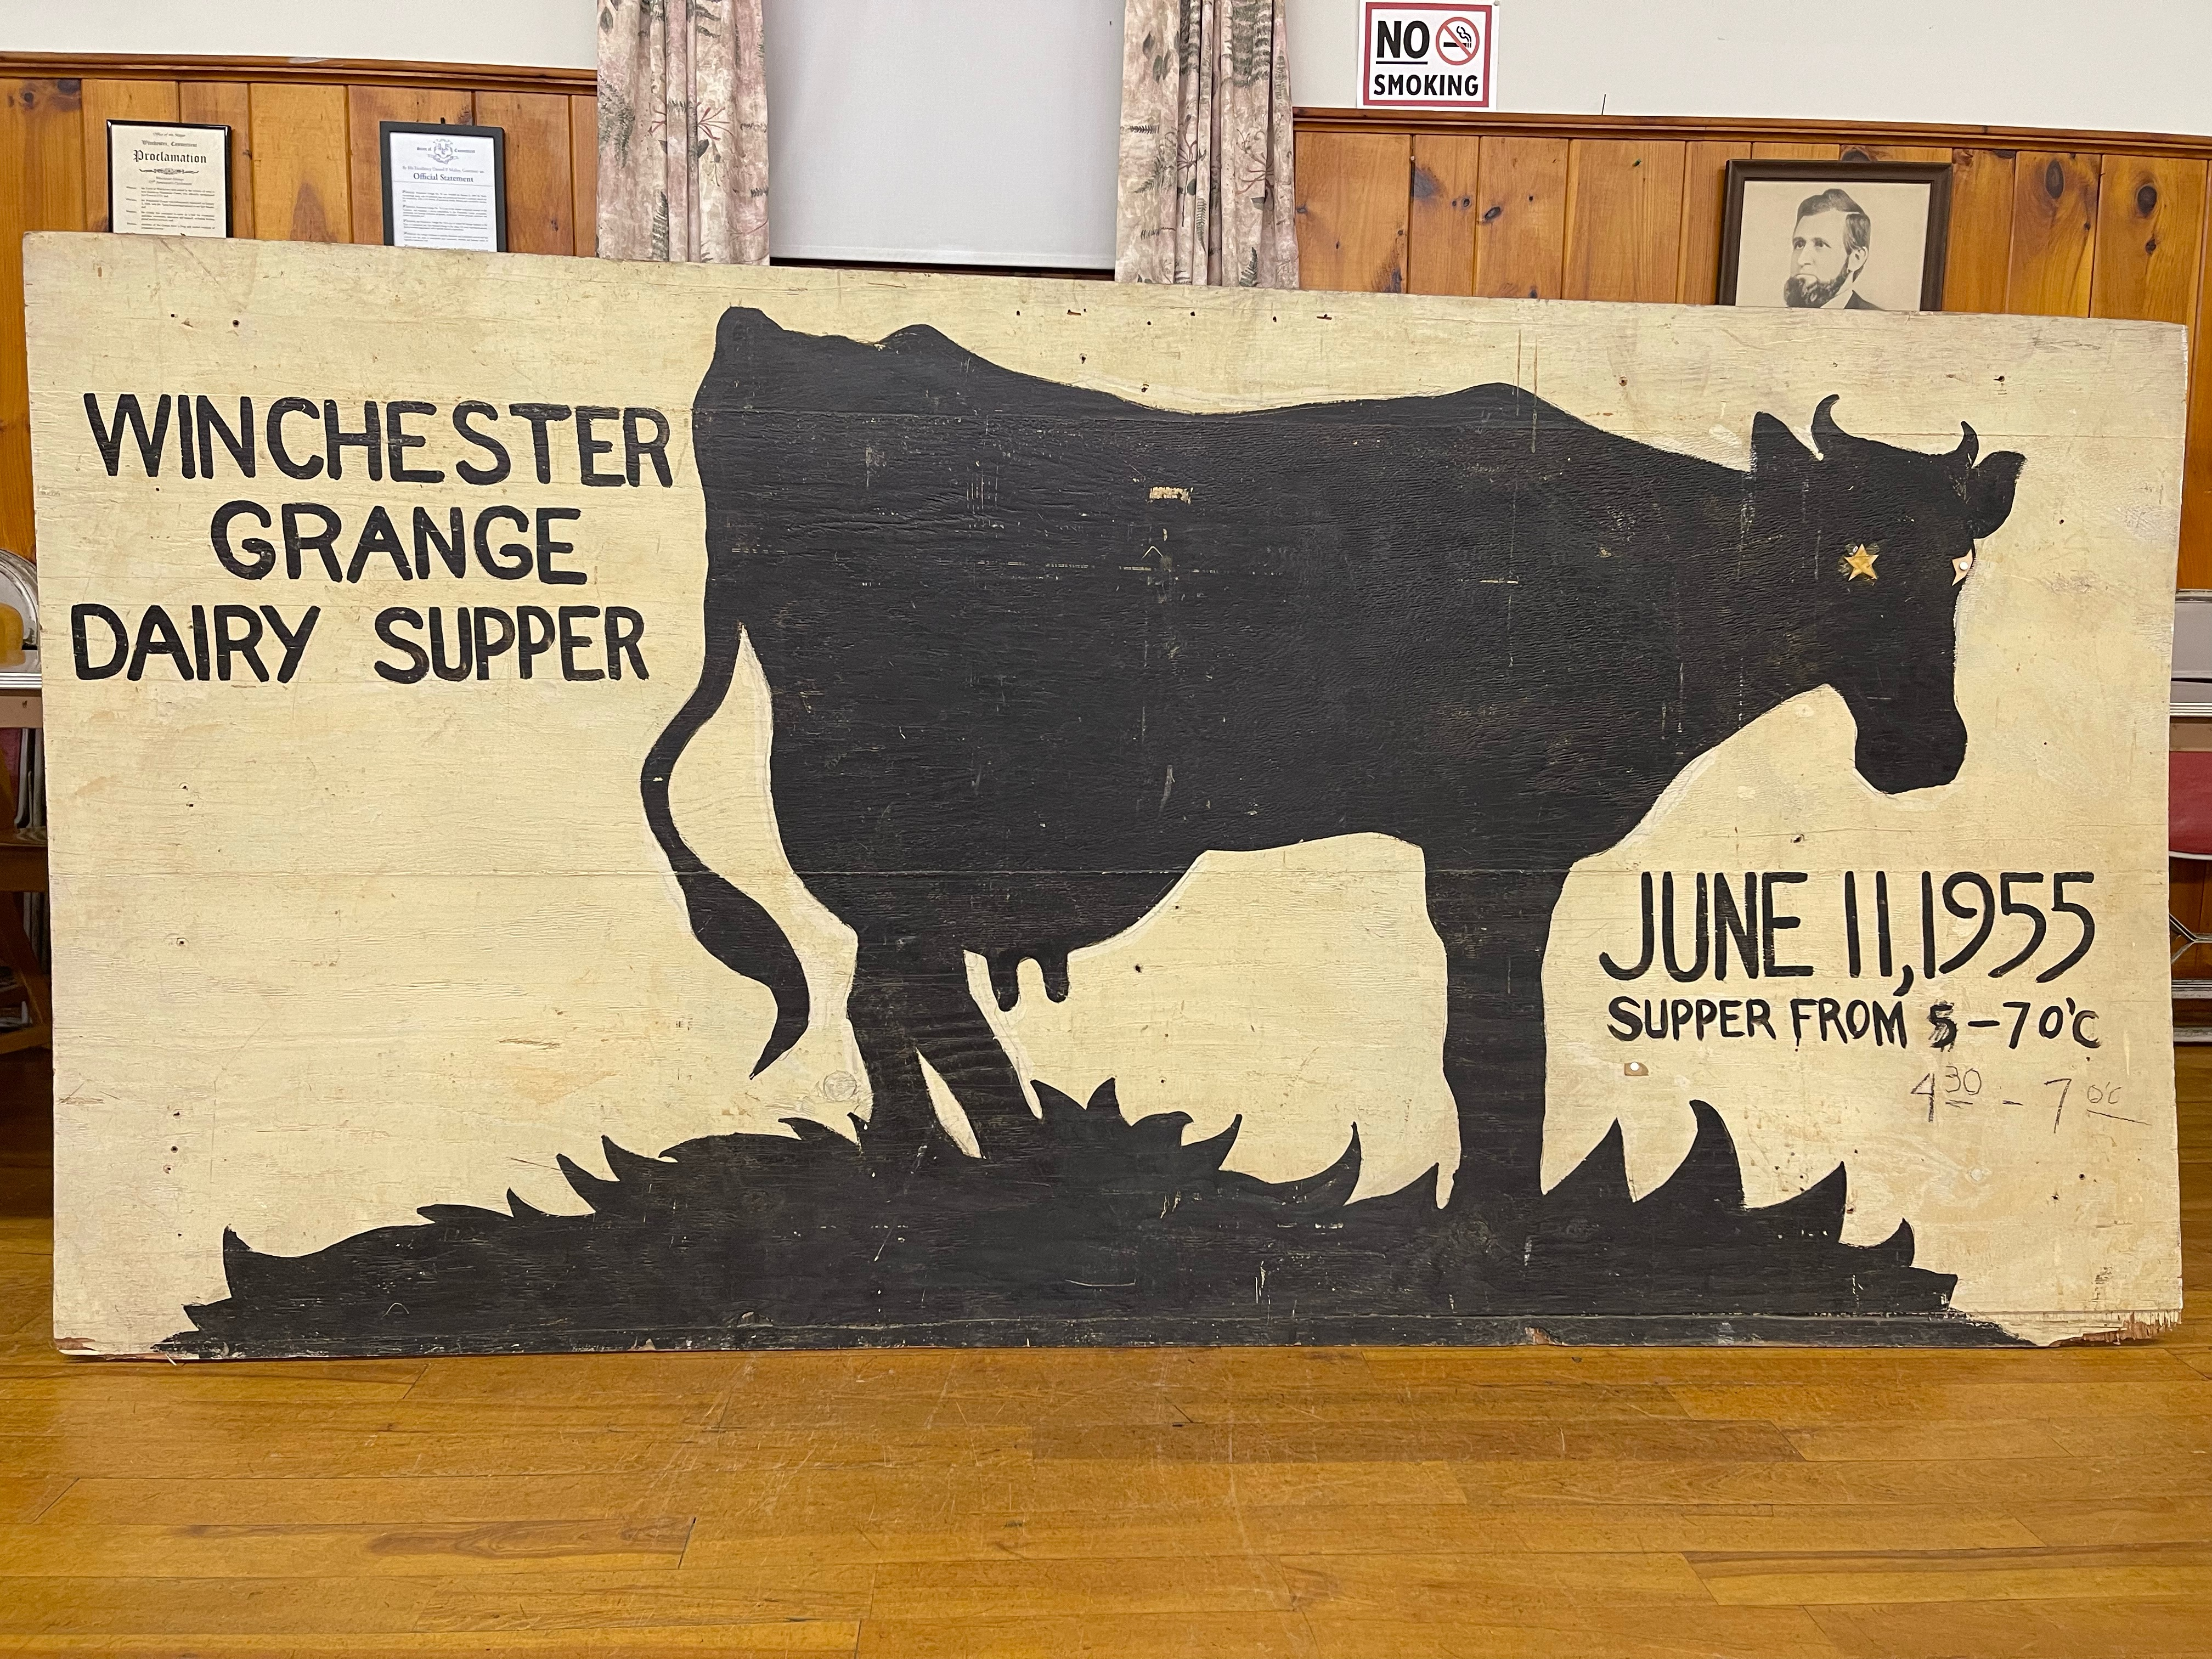
Potluck Ideas
Decades Theme: Ask guests to bring dishes inspired by a specific decade, such as the 1950s or the 1980s. It adds a touch of nostalgia and allows guests to get creative with retro recipes.
Ingredient Challenge: Pick a unique ingredient and ask guests to create a dish showcasing that ingredient. (i.e. Bacon, Cheese, etc.) It’s a fun and creative way to inspire culinary creativity. Longtime Grangers will remember the Dairy Dinners/Suppers.

Slide 18
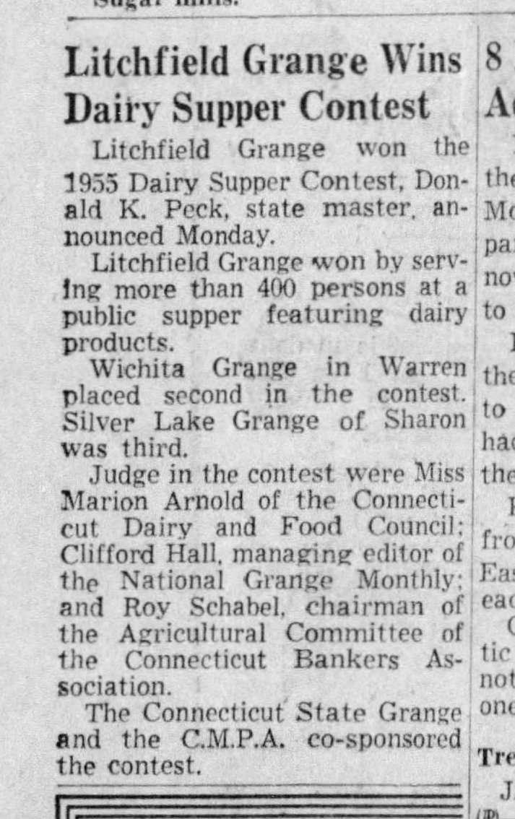
Grange Dairy Dinners/Suppers
During his first term as State Grange Master/President in 1953, Don Peck introduced the Dairy Supper Contest. Granges across Connecticut competed and won a monetary prize of $50 for serving the most people at a public dinner, featuring dairy products. The contest grew in popularity, and was picked up by National Grange and instituted as a National Contest in 1955, where the prize increased to $100. The contest ran until the 1960s, although some Granges still hosted Dairy Suppers thereafter.

Slide 19
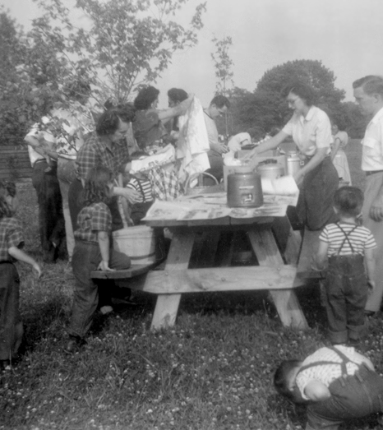
Potluck Ideas
When choosing a theme, ensure that it allows for a variety of dishes and provides options for different dietary needs.
Remember, a theme enhances the overall experience of your potluck and encourages guests to get creative with their dishes. It adds an element of excitement and conversation as everyone discovers and shares their culinary creations.

Slide 20
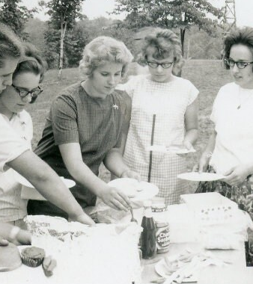
Popular Potluck Dishes
When it comes to potlucks, some dishes have become beloved staples. These are the top Potluck dishes according to a survey from Storables.com
Deviled Eggs
Baked Macaroni and Cheese
Potato Salad
Gelatin Salad
Pulled Pork Sliders
Chocolate Chip Cookies
Spinach and Artichoke Dip
Fruit Salad
Veggie Platter
Finger Sandwiches

Slide 21
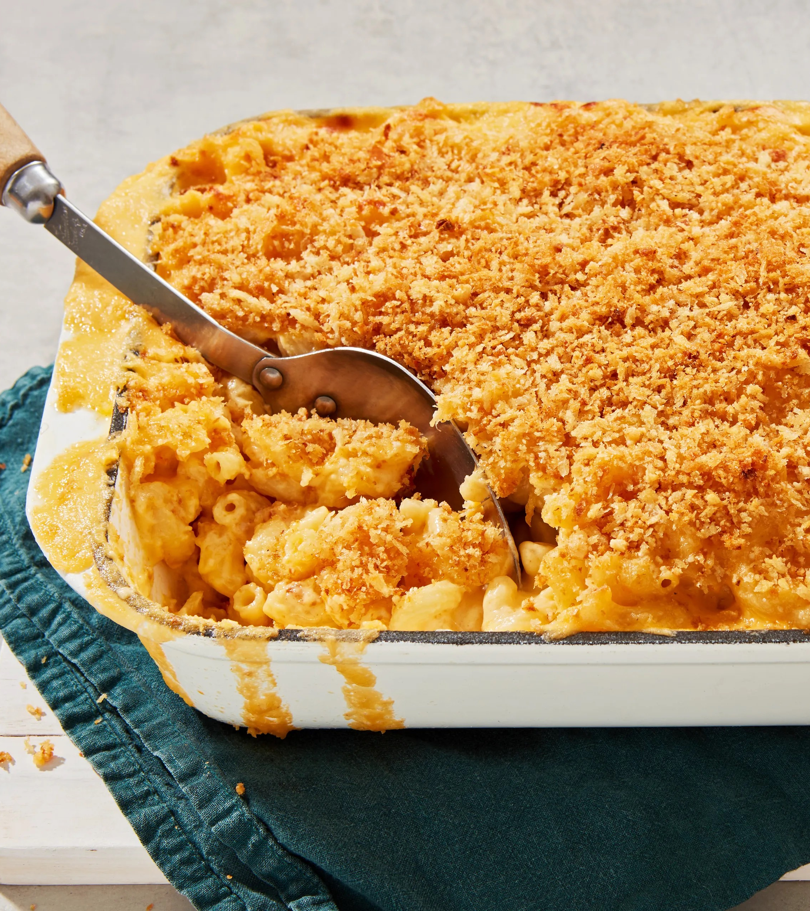
Potluck Favorites
What are your favorite potluck dishes?
Let’s Discuss!!
Email Terri (information@ctstategrange.org) your favorite potluck recipe and she will compile them and mail them to those interested in receiving them.

Slide 22
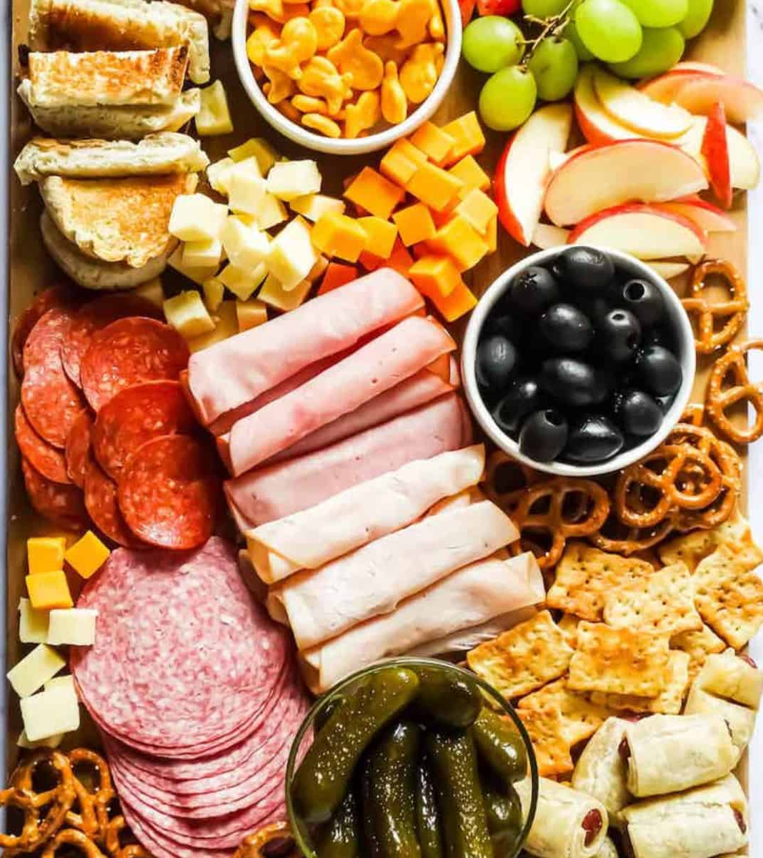
Modern Day Potluck: Charcuterie Boards
The charcuterie board is experiencing a bit of a Renaissance. Pronounced “shaar-koo-tr-ee,” you may know it as a meat and cheese board, vegetable platter or appetizer platter. They’re usually laid out on a wooden board or other large platter and arranged in a way that’s appealing to the eye as well as the nose.

Slide 23
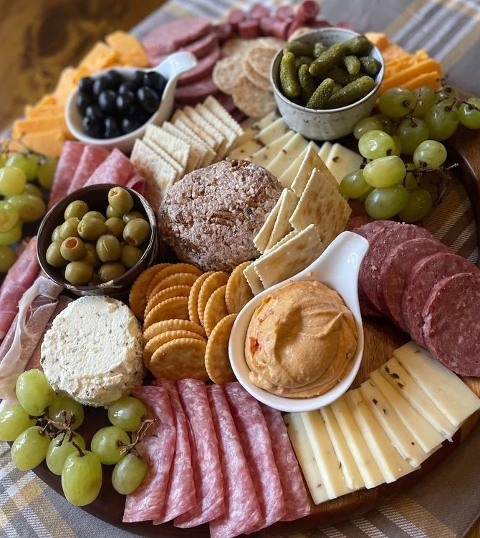
Modern Day Potluck: Charcuterie Boards
The word charcuterie is French, and describes the practice of cooking with meat products. It is derived from the words “chair,” which means “meat” and “cuit,” which means “cooked.”
Charcuterie boards are one of those things that no two people would prepare the same way, which is what makes them so great. There are literally endless options for the items to include on a charcuterie board, as well as ways to arrange them.

Slide 24
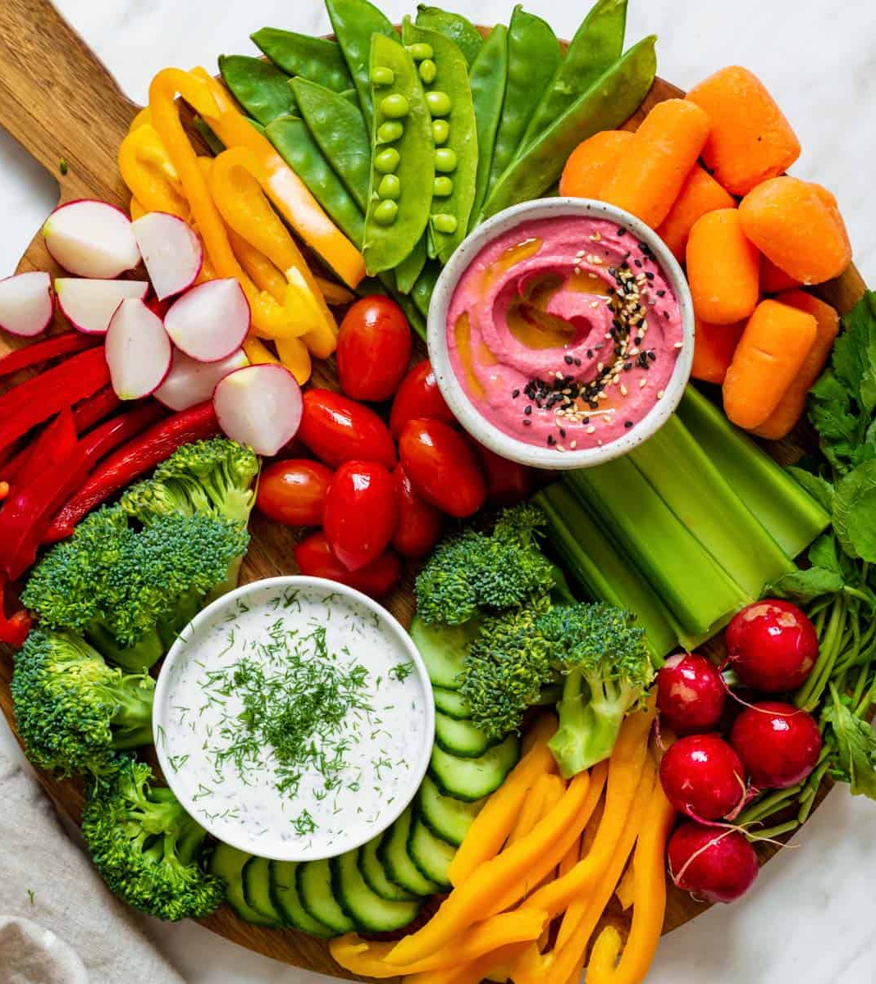
Modern Day Potluck: Charcuterie Boards
These creative snack boards are endlessly customizable and fun to put together, with so many variations to choose from beyond the traditional spread of cured meats and cheeses.
These are great for refreshments after your Grange meeting or at a Neighbor’s Night, adapt easily to theme nights, are perfect for a Potluck, and even make great gifts for home-bound members during the holidays.

Slide 25
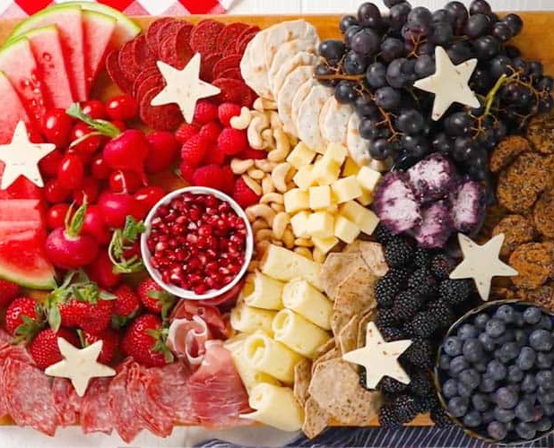
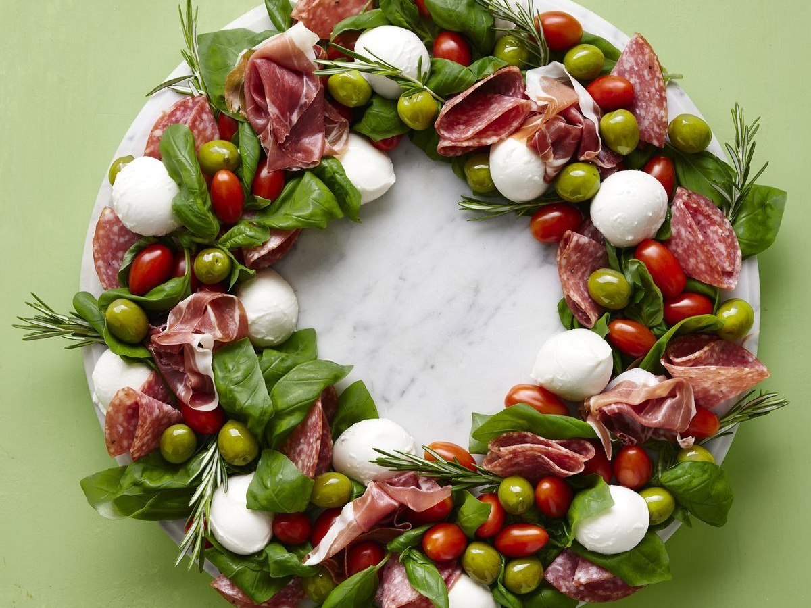
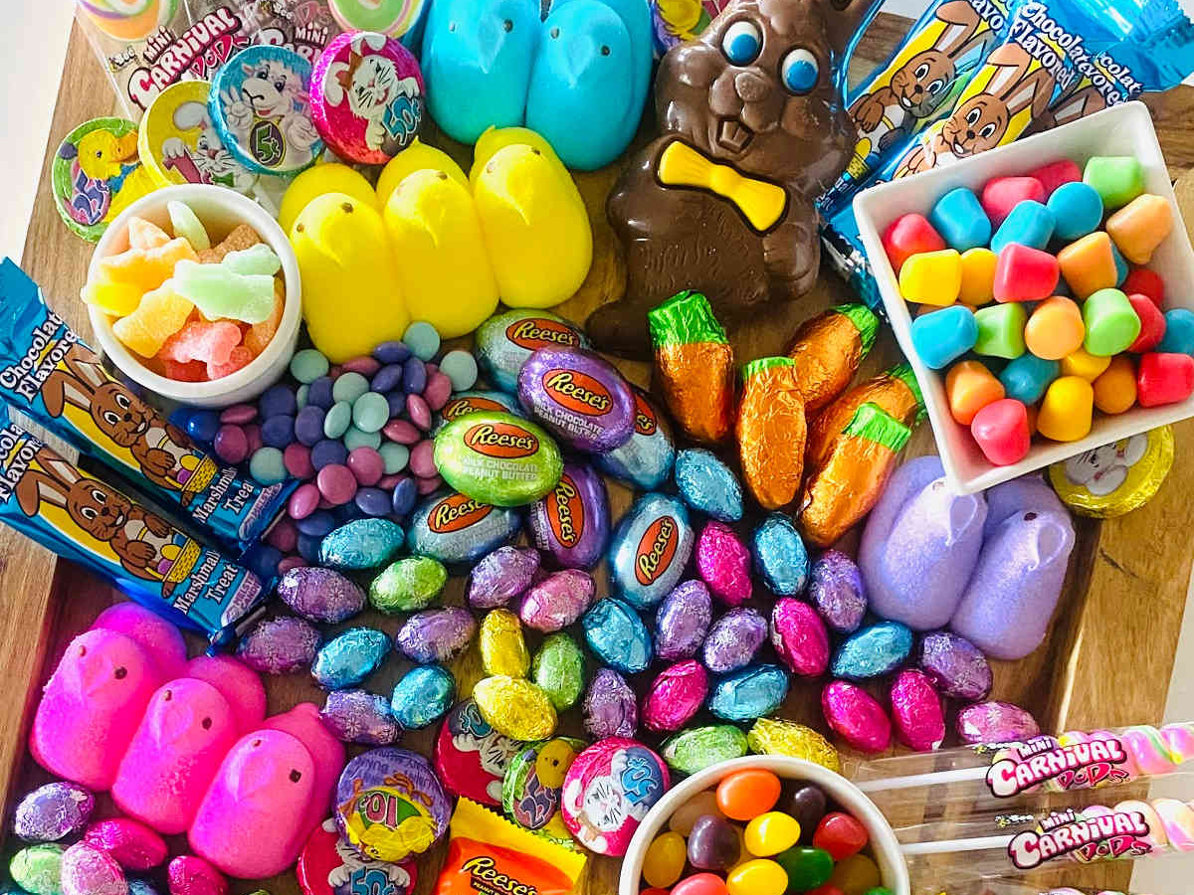

Slide 26
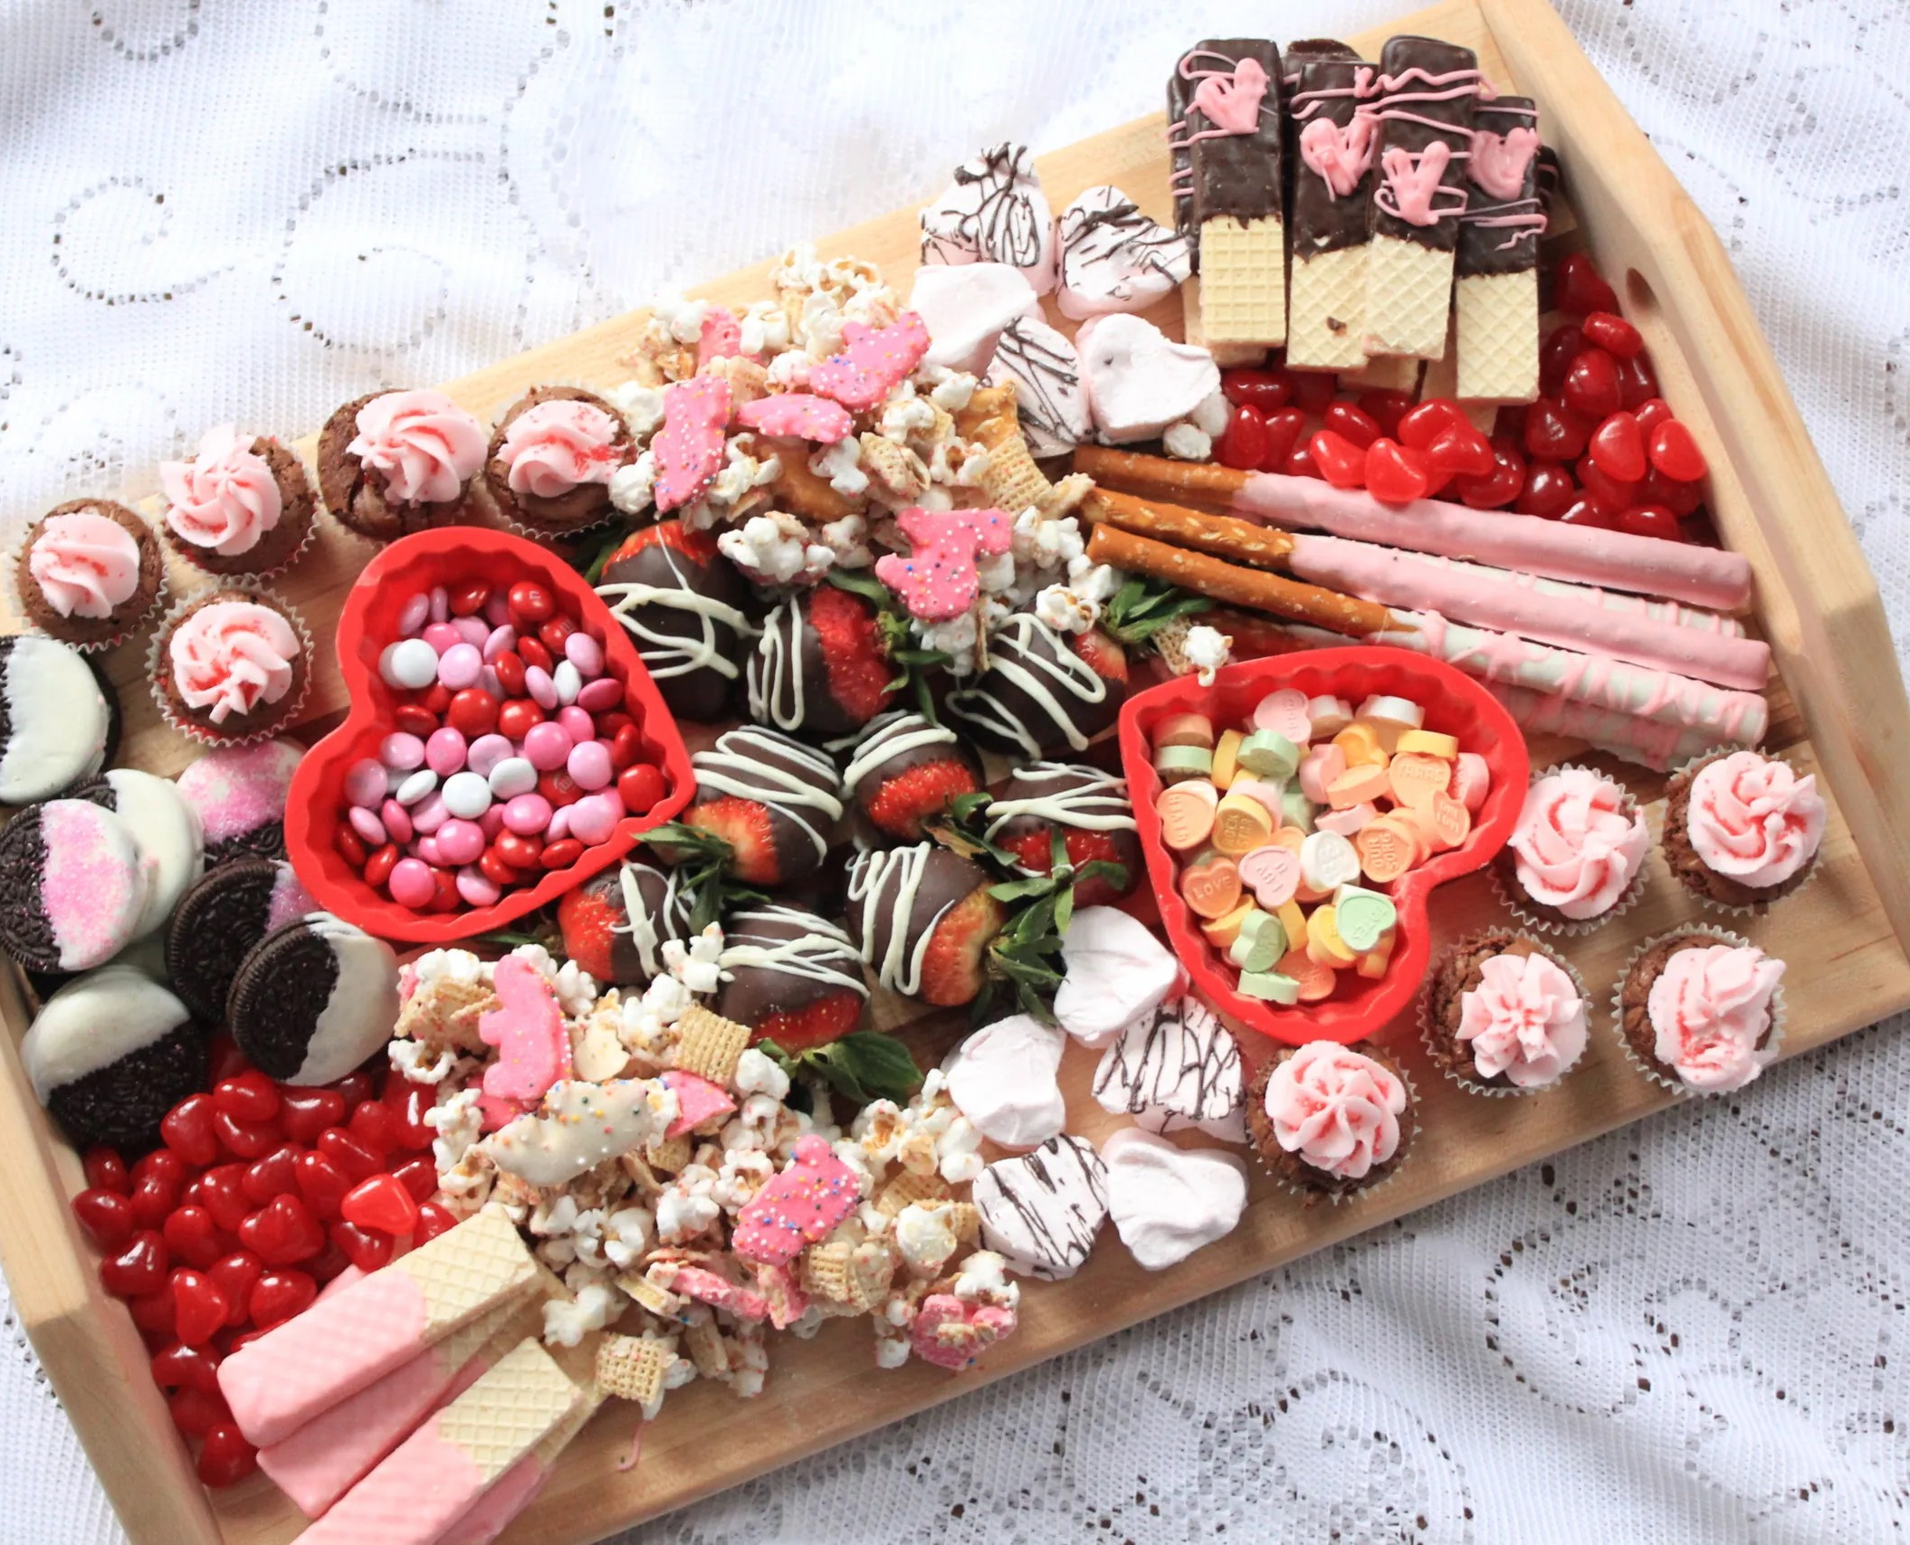
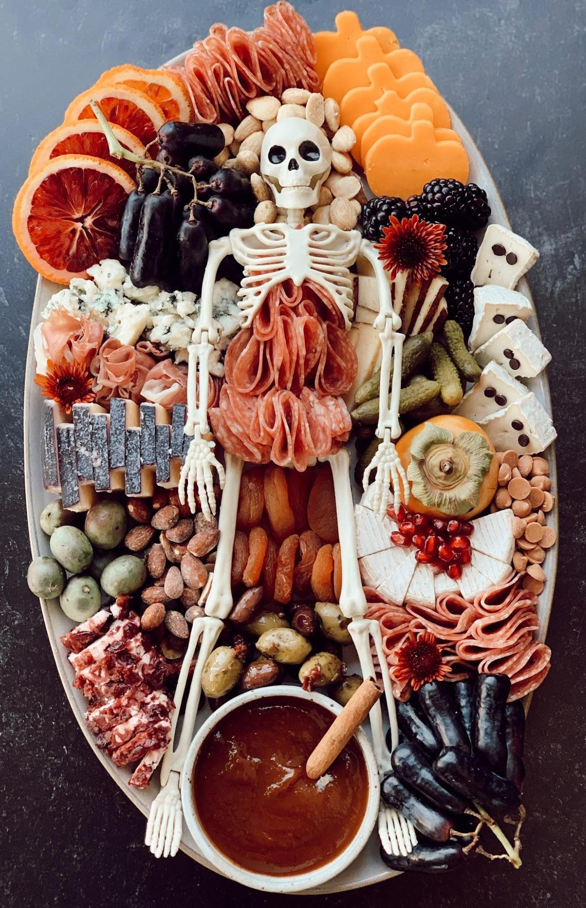

Slide 27
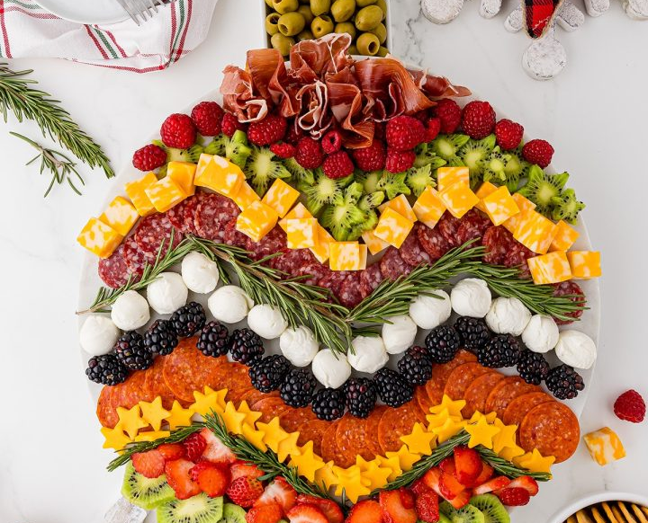
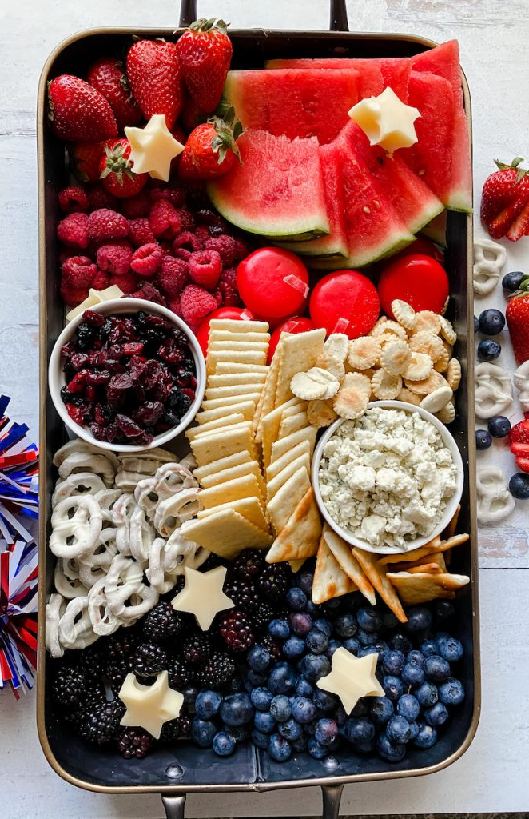

Slide 28

Potluck Fun:
The Price Is Right
We will see photos of common food items used in potlucks. Guess the price!
Note: Prices were compiled using the Connecticut Stop & Shop circular from the week of
August 23-29, 2024.

Slide 29
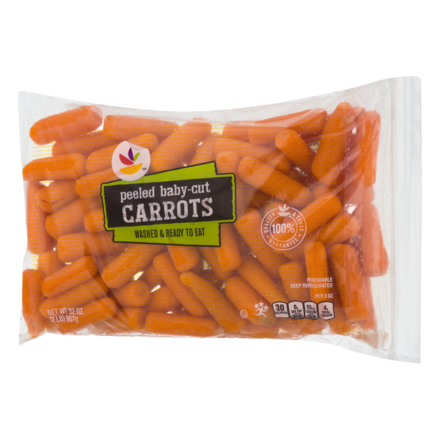
Peeled Baby Carrots
32oz. - 2lb - washed and ready to eat.

Slide 30
Peeled Baby Carrots
32oz. - 2lb - washed and ready to eat. Stop & Shop Brand.
99¢

Slide 31
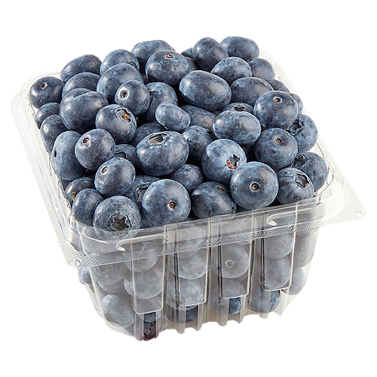
Blueberries
1 pint package

Slide 32
Blueberries
1 pint package
$3.00

Slide 33
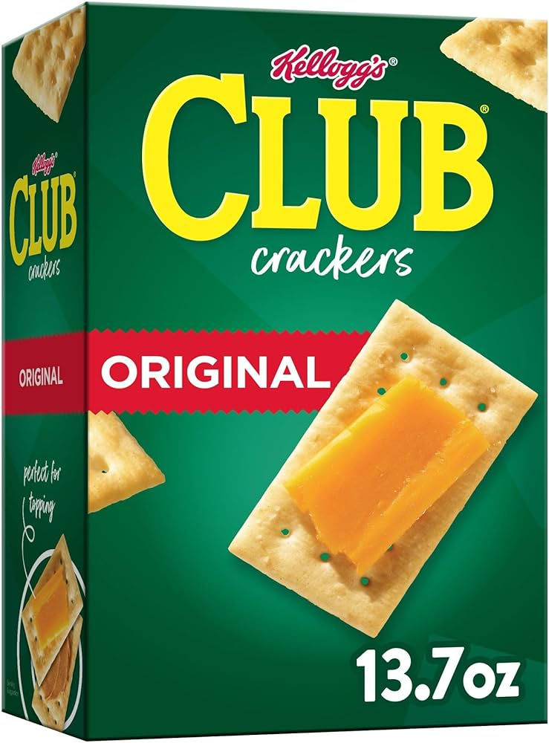
Kellogg’s Club Crackers
13.7 oz package

Slide 34
Kellogg’s Club Crackers
13.7 oz package
$3.50

Slide 35
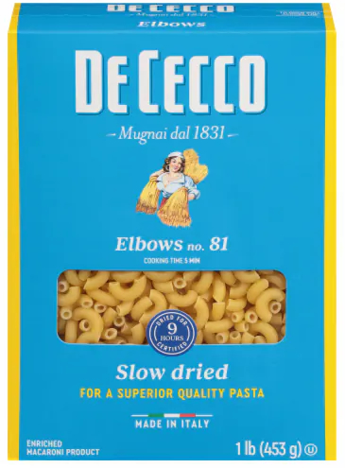
DeCecco Pasta
Elbows No. 81 - 16oz / 1 lb package

Slide 36
DeCecco Pasta
Elbows No. 81 - 16oz / 1 lb package
$2.00

Slide 37
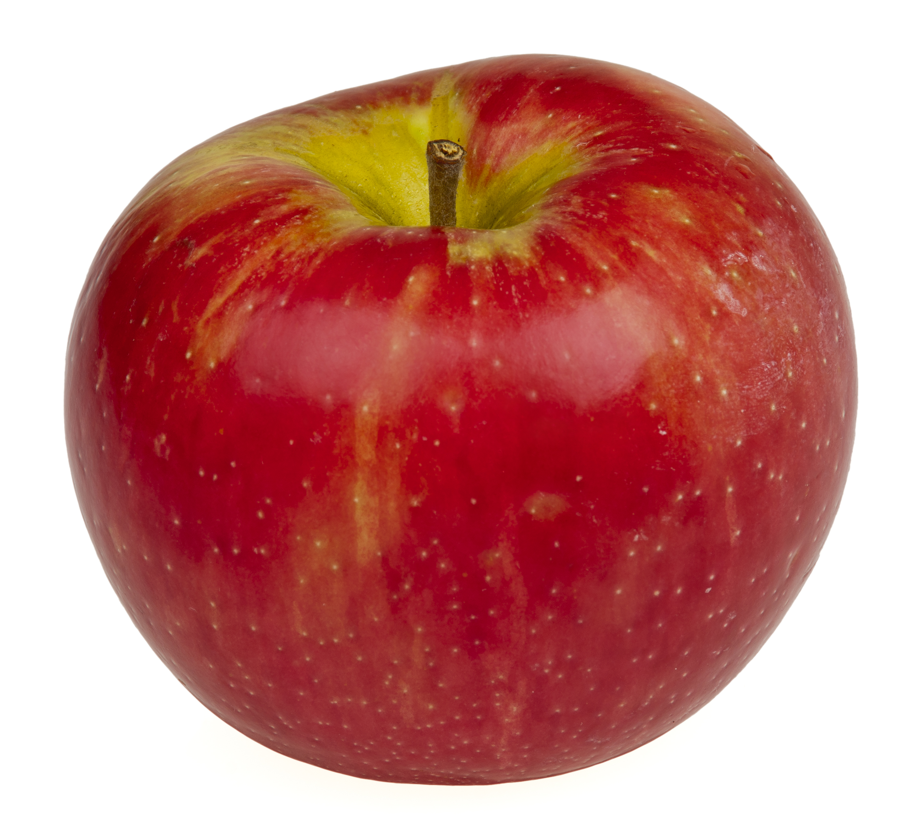
Honeycrisp Apple
Price per 1lb - Extra Fancy

Slide 38
Honeycrisp Apple
Price per 1lb - Extra Fancy
$1.79

Slide 39
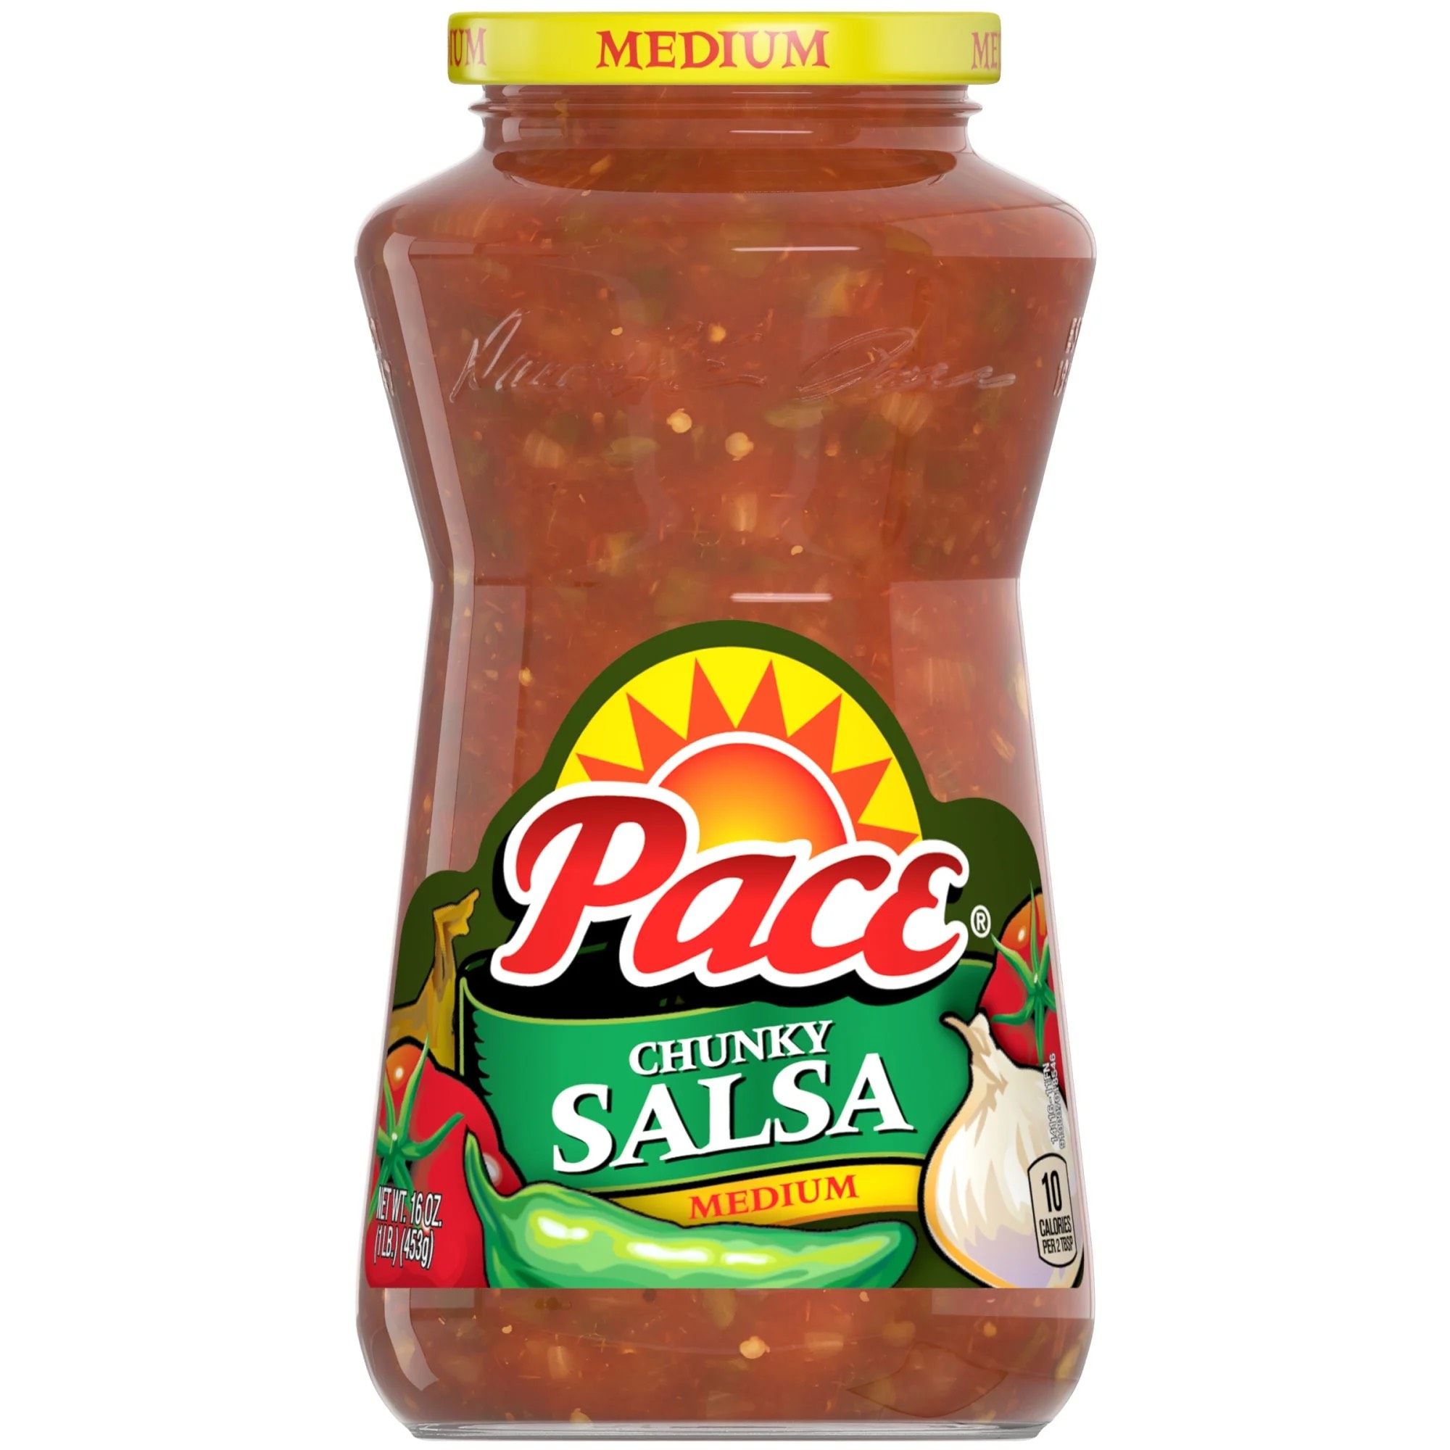
Pace Chunky Salsa
Medium Heat - 16oz Jar

Slide 40
Pace Chunky Salsa
Medium Heat - 16oz Jar
$2.49

Slide 41
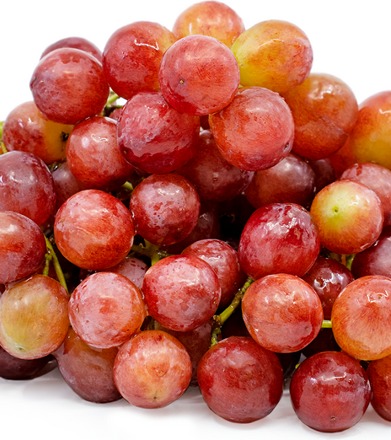
Red Seedless Grapes
Price per 1lb

Slide 42
Red Seedless Grapes
Price per 1lb
$1.27

Slide 43
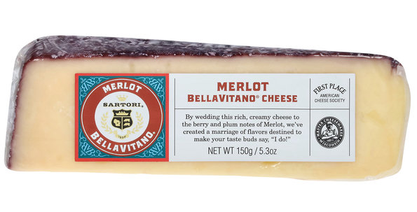
Sartori Cheese Wedge
Merlot BellaVitano - Rich Creamy Cheese - 5.3 oz Wedge
Found in the Deli Department

Slide 44
Sartori Cheese Wedge
Merlot BellaVitano - Rich Creamy Cheese - 5.3 oz Wedge
Found in the Deli Department
$4.99

Slide 45
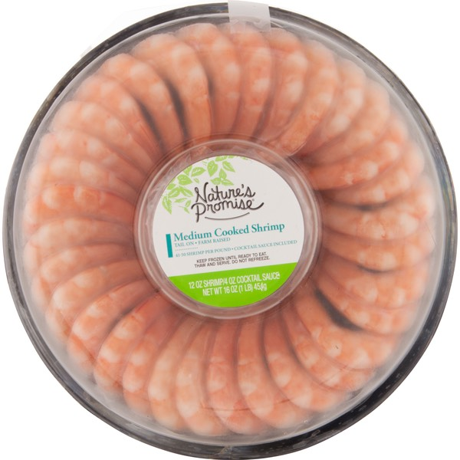
Nature’s Promise
Shrimp Ring
Medium Cooked Shrimp - 16oz Package -
Sold with 4oz Cocktail Sauce

Slide 46
Nature’s Promise
Shrimp Ring
Medium Cooked Shrimp - 16oz Package -
Sold with 4oz Cocktail Sauce
$9.99

Slide 47
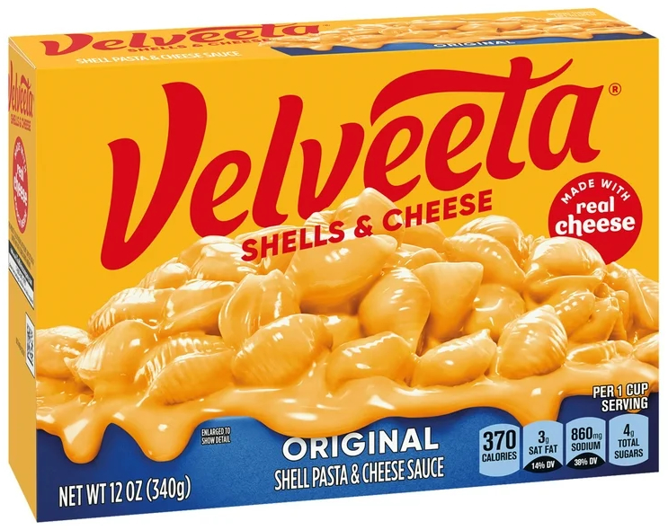
Velveeta
Shells & Cheese
Shell Pasta and Cheese Sauce - Original Flavor -
12 oz. Package - Made with Real Cheese

Slide 48
Velveeta
Shells & Cheese
Shell Pasta and Cheese Sauce - Original Flavor -
12 oz. Package - Made with Real Cheese
$3.29

Slide 49
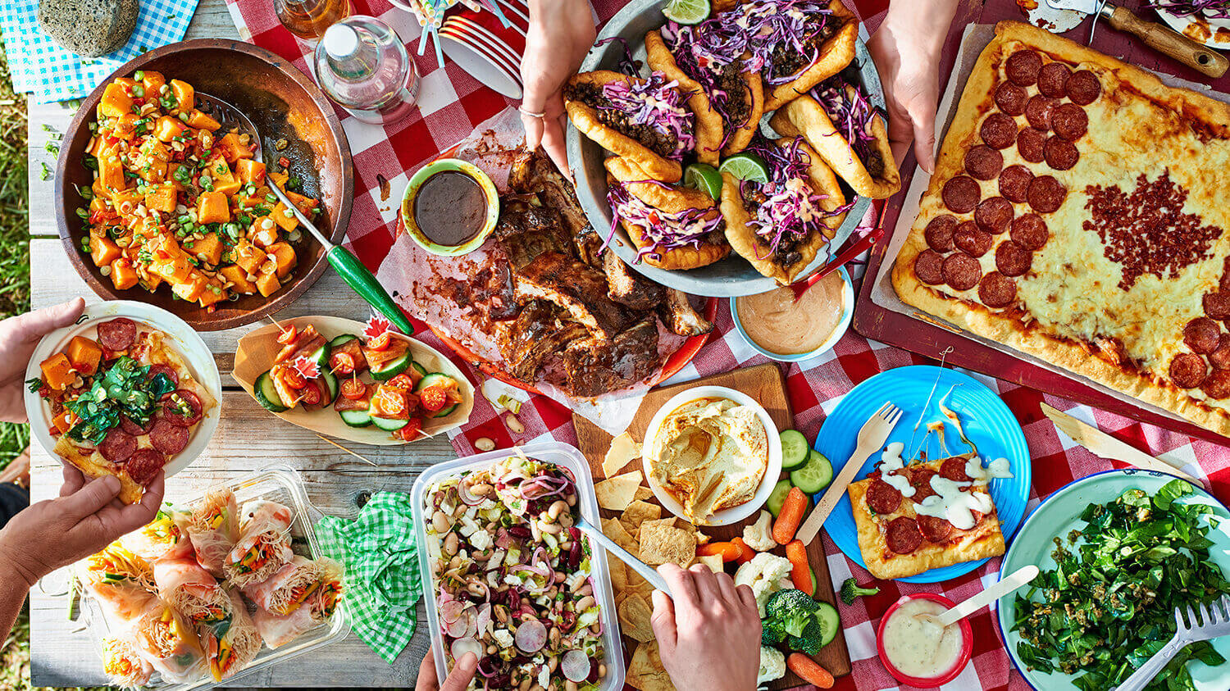

Slide 50
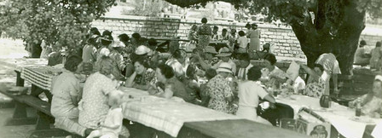
The Potluck Experience
So, whether you’re Grange is hosting its first potluck or has years of potluck experience, embrace the spirit of collaboration, creativity, and community that potlucks embody. Enjoy the feast, savor the flavors, and appreciate the connections made around the shared table.

Slide 51
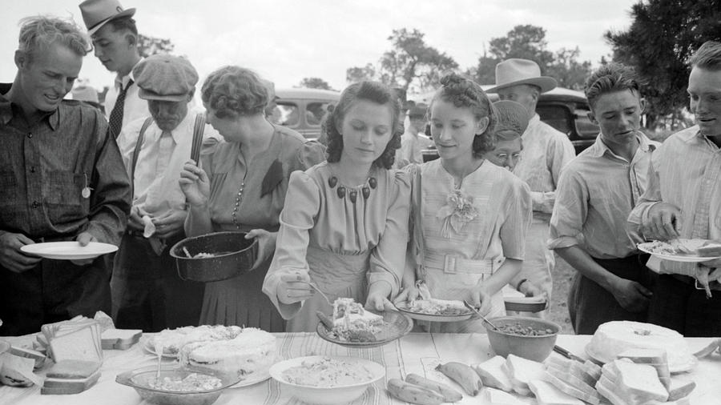

Slide 52
“Food is as much about the moment, the occasion,
the location and the company as it is about the taste.”
– Heston Blumenthal

Slide 53
Thursday, August 29, 2024 © Connecticut State Grange

