Slide 1


Slide 2

What is Promotion?
In the commercial world, promotion is a marketing tool, used as a strategy to communicate between the sellers and buyers. Through this, the seller tries to influence and convince the buyers to buy their products or services. It assists in spreading the word about the product, services or company to the people. The company uses this process to improve its public image. This technique of marketing creates an interest in the mindset of the customers and can also retain them as a loyal customer.

Slide 3
Let's translate this definition to the Grange
Promotion is a marketing tool, used as a strategy to communicate between the Grange, its members and the public. Through this, the Grange tries to influence and convince their members, as well as the public, to support their projects and activities. It assists in spreading the word about the projects and activities, or the Grange itself as an organization, to the public. The Grange uses this process to improve its public image. This technique of marketing creates an interest in the mindset of the public and can also retain members and loyal supporters.

Slide 4

The Most Common Types of Promotions:
There are 6 common types of promotions.
• Advertising
• Direct Promotions
• Sales Promotions
• Self Promotions
• Public Relations
• Online Promotions

Slide 5
Advertising:
• A tool for spreading the word or awareness of an activity or project or of the organization itself. This can be free, but is often paid. An advertisement is communicated through many traditional media outlets such as radio, television, outdoor advertising/billboards, and newspapers. Other contemporary media that supports advertisements are social media, blogs, text messages, and websites.

Slide 6
Direct Promotions:
• A type of promotion where the organization directly communicates with its members or public. This communication is usually done through various approaches like personal email marketing, text messaging, flyers and posters, USPS letters and post cards, and more. For example, your Grange does a USPS mailing of a letter to all of the members about their upcoming fair.

Slide 7
Sales Promotions:
• This utilizes all sorts of marketing tools to communicate with the target audience (both members and the public) and increase sales of item(s) (or in the case of the Grange, the Sales could be membership). However, it is for a limited time, used to expand demand, refresh market demand or enhance product availability. For example - Buy One, Get One Free promotions.

Slide 8
Self Promotions:
• This is a process where the organization sends their officers or members directly to the public to pitch for their activities, projects, or for the organization itself. Here, the response for the feedback of the public is prompt and therefore, easy to build a trust with the audience. For example, face to face and phone communications.

Slide 9
An Example…
In the summer of 1969, thirty-two bands were scheduled to perform on a small dairy farm in New York State. Promoters figured no more than 200,000 people would attend. Because of word of mouth - over 400,000 people showed up. The event is now simply known as Woodstock.
Imagine if every one of your members were talking about your Grange like Woodstock fans spread the word about the concert, and wanted to share your Grange with everyone they knew. You’d double your growth in no time flat.
That’s the power of Word of Mouth (Self-Promotions).

Slide 10
Public Relations:
• PR is a strategic plan or campaign using varied but specific exercises to broadcast information or messages between the organization, individuals (members) or the public. A powerful PR campaign can be valuable to the organization as it is generating interest in the organization itself more than selling something specific - like an event or activity. For example, a spotlight article in the newspaper about a long-time member, or a historical retrospective.

Slide 11
Online Promotions:
• This can include most all elements of the other types of promotions, but the promotion is done in an online environment. Examples include websites, social media, mass emails, internet newsletters, paid internet ads, and more. For example, your Grange’s Facebook page.

Slide 12
Marketing vs. Promotions
In short, marketing focuses on increasing the awareness of a product and getting it in front of potential customers.
Promotions are the final step of marketing – they provide the needed incentive to turn visitors into buyers.
All in all, marketing vs promotion is about awareness vs conversion.
Granges need to embrace both marketing and promotions.

Slide 13
Why Promote Your Grange?
To spread your Grange’s message and Mission/Vision
To bring in new members
To showcase your Grange’s successes
To create donation opportunities
To explore relationships with other organizations
To gain exposure / keep your Grange visible
To alert the public to events, activities, projects
To reach the public with the work of your Grange
(i.e. Community Service)

Slide 14
Promotional Methods:
Offer incentives
Create excitement / buzz
Keep current members engaged
Run a media campaign (press releases, etc.)
Ask members to tell their friends and family about the Grange
Share testimonials
Create attention-getting materials (brochures, etc)
Build trust with your members

Slide 15
Promotional Methods:
Go the extra mile for your members; make members feel important
Thank your members regularly
Let people brag about your Grange
Always be ready to spread the word and answer questions about the Grange (elevator speech)
Recruit others to share your content
Do more of what resonates in your community
Make it easy for your community to find your Grange

Slide 16
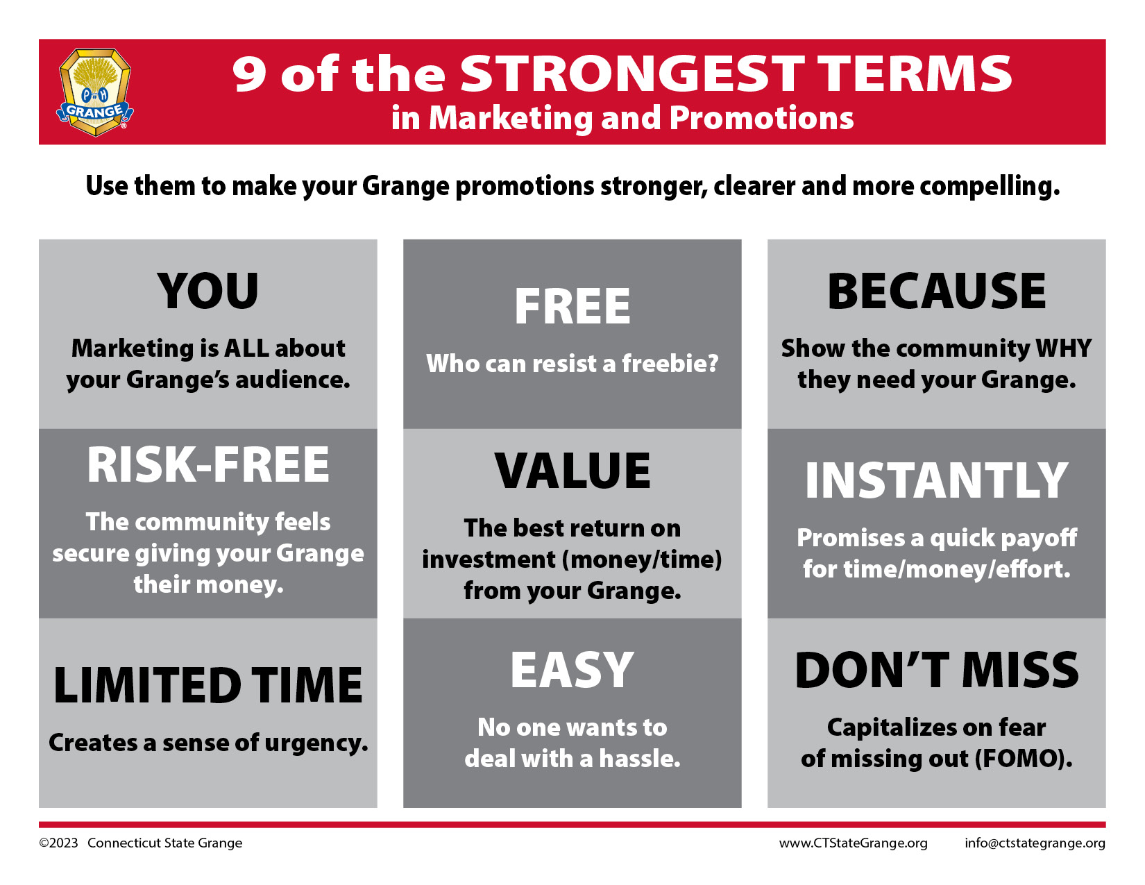

Slide 17
What is a SWOT Analysis?
Businesses regularly analyze their processes to ensure they are operating as efficiently as possible. One of the most effective methods to achieve this is to conduct a SWOT analysis. SWOT stands for strengths, weaknesses, opportunities and threats. This method was created in the 1960s by Albert Humphrey of the Stanford Research Institute, during a study conducted to identify why corporate planning consistently failed. Since its creation, SWOT has become one of the most useful tools
for business owners to start and grow their companies.

Slide 18
Create a SWOT Analysis of your Grange
It’s beneficial to perform a general SWOT analysis on your Grange to check on the current landscape of your operations, so your Grange can improve as needed. The analysis can show you the key areas where your organization is performing optimally, as well as which operations need adjustment.

Slide 19
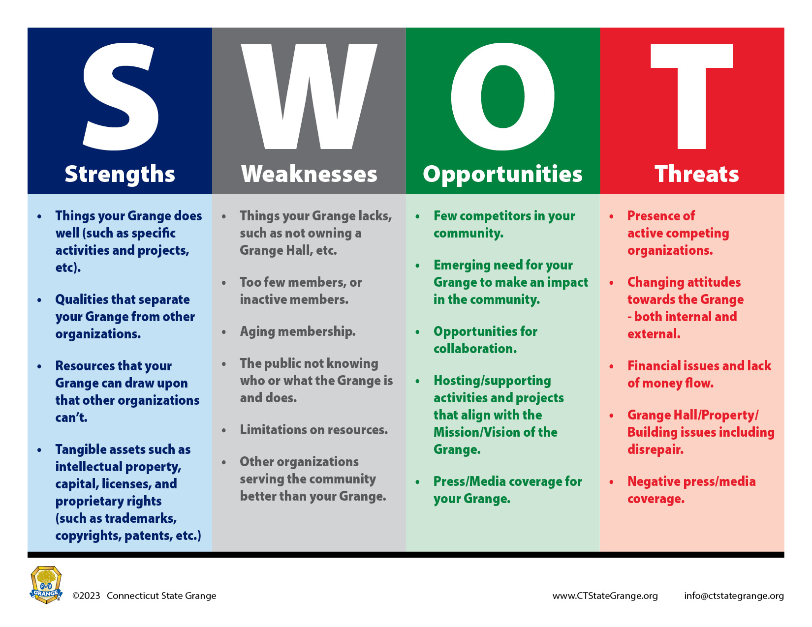

Slide 20
Traditional Promotions
Traditional promotional methods can connect your Grange with the public by providing information through a variety of means.
Press releases and articles
Hosting public events and activities
Flyers, brochures, business cards
Advertisements in newspapers/magazines, on the radio, television, etc.
Promotional merchandise
Endorsements

Slide 21
TIPS: Traditional Promotions
Post and hand out flyers and/or free merchandise at events and places where potential members are likely to be.
Take advantage of free publicity.
Invite a chef, reporter, celebrity, photographer, etc. to your events and activities to share your story.
Develop and distribute a press release that tells your Grange’s story and provides current and historical information. Provide it to the media (newsprint, television and radio), students, bloggers, family and friends who will share it with others through word-of-mouth, the web and social media.

Slide 22
What is a Press Release?
Press releases exist to share news about your Grange. Therefore, what you’re sharing should be newsworthy—meaning that there’s a reason you’re sending it at the moment you send it.
There are distinctive types of press releases:
General News. This is the most common type of press release. For example, when your Grange presents an award or honors a community citizen.
Events. This type of press release needs to clearly explain the details of an event. The goal is to have the event specifics printed in the media so the general public can learn about them.

Slide 23
What is a Press Release?
Launch. A launch press release relates to the release of a new project, item, website, initiative or something similar.
Positional. This type of press release would introduce new officers, or spotlight a member. A press release of this genre is story-based, and often includes fairly extensive biographical/historical information about the person or Grange. At least one photo should be included, too.
Expert. This type of press release is used to establish a Grange’s credibility in a particular field. An expert press release provides a general introduction as well as some type of verification of expertise.

Slide 24
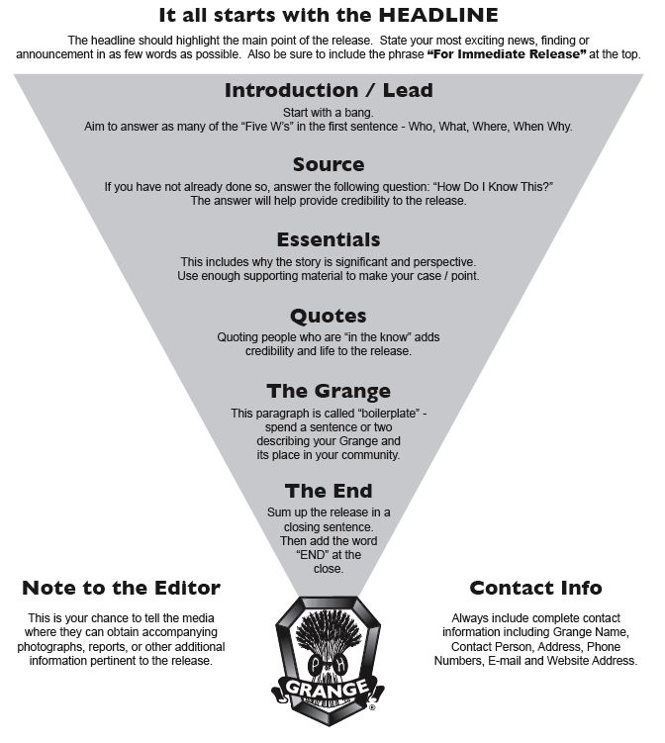

Slide 25
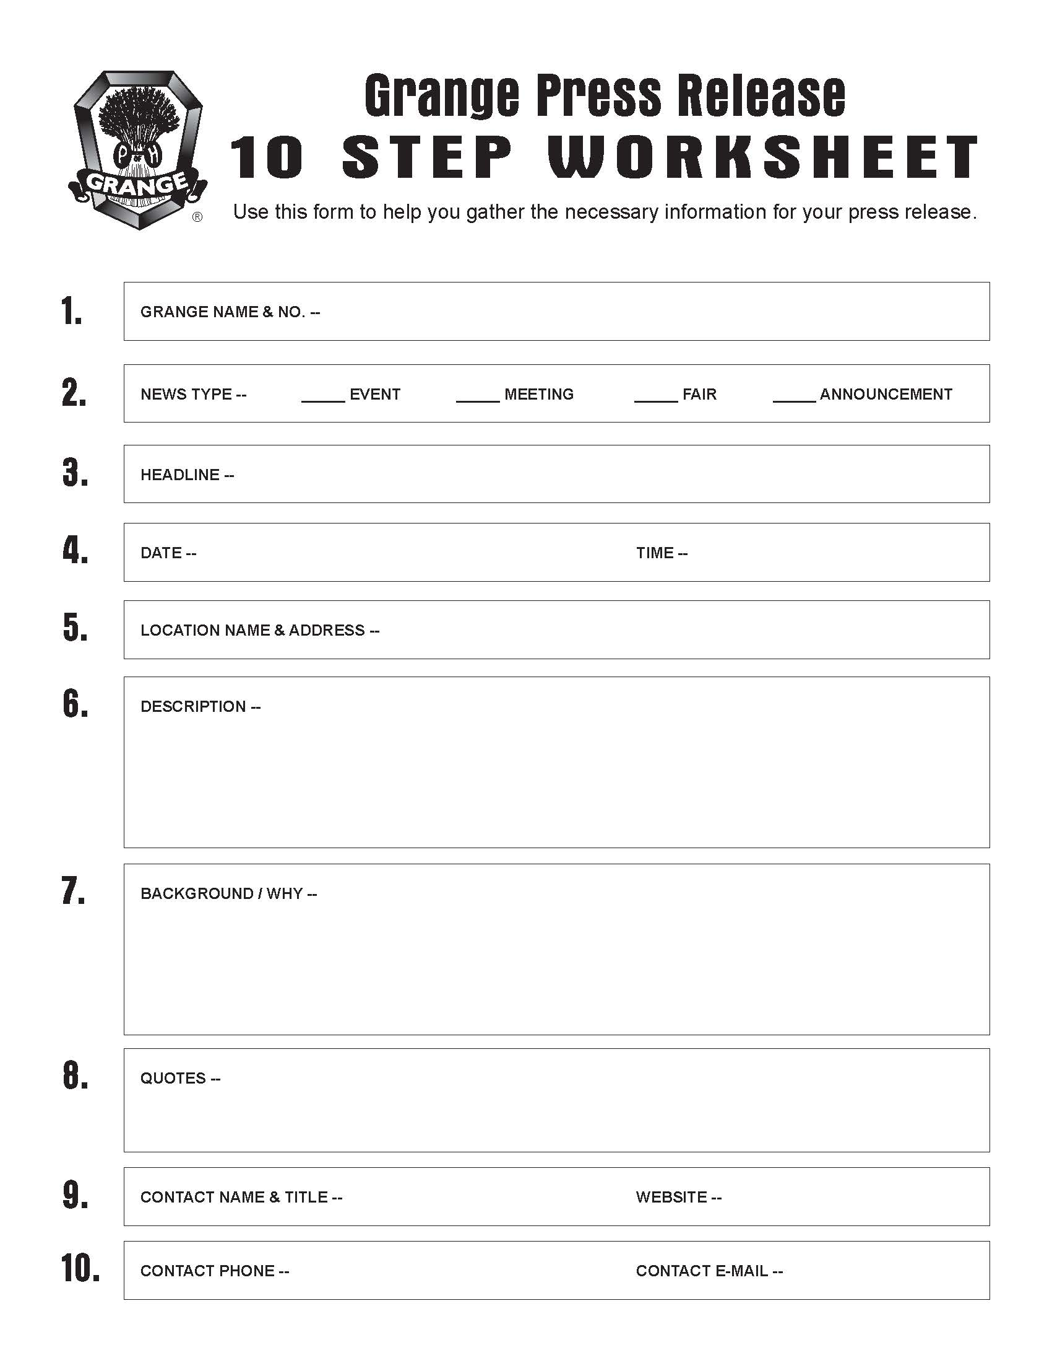

Slide 26
Accentuate the Positive:
Whether it’s via traditional media such as newspapers and magazines, social networking such as Facebook, Instagram and Twitter, or online media sources, such as Topix or NewsWire, - good practices are a terrific way to bring a flood of interest, inquiries and potentially new members to your Grange. But if you want truly legendary results in your quest
to grow your Grange, you need to keep a positive attitude and show enthusiasm about your Grange, and convey those feelings to others.
The wrong approach is to send a negative news release (especially one lacking real news) far and wide, to publications ranging from “The Wall Street Journal” to your local shopping weekly. First, this is unlikely to get reporters calling and broadcast vans rolling, because there are millions of businesses and people competing for scarce ink and air time.

Slide 27
Accentuate the Positive:
Second, negative publicity may get your Grange noticed by the media, but not in the way you had in mind. If your target media writes you off as a dying group, you probably will not get a second chance to generate good press.
Attracting the right attention and inspiring the media to write about and/or publish pictures of your Grange activities is one of your goals - and creating a positive spin is a key in achieving success.

Slide 28
Accentuate the Positive:
Take a look at the following two examples. If you were a prospective
member and saw the two articles, which one would encourage you to join the Grange?
The Bad: Example of a negative headline and lead paragraph:
Prospects for struggling Grange are grim without support
Unless community members step up and help, the doors of XOXOX Grange No. 000 will close on a historic connection started in 1890. Membership in the Grange has declined, but it is the lack of participation that could mark the end of the group, according to officers Joe Smith and John Doe.

Slide 29
Accentuate the Positive:
The Good: Example of a positive headline and lead paragraph:
XOXOX Grange celebrates 133rd Anniversary with new Community Service Project
Established in 1890, XOXOX Grange No. 000 will be celebrating its 133rd Anniversary by undertaking a new project - donating 133 lap robes to the Veterans Home. Community service projects have been the backbone of XOXOX Grange, with projects such as donating to the food pantry, presenting scholarships, and more. But despite all of the Grange’s work, members were growing older and tiring. According to officers Joe Smith and John Doe, they hope this new project will be the infusion of interest needed to bring XOXOX Grange back on track with its membership goals.

Slide 30
Press Release Tips:
Make sure the information is newsworthy.
Tell the audience that the information is intended for them and why they should continue to read it.
Start with a brief description of the news, then distinguish who announced it, and not the other way around.
Ask yourself, “How are people going to relate to this and will they be able to connect?”
Make sure the first 10 words of your release are effective, as they are the most important.
Avoid excessive use of adjectives and fancy language.
Deal with the facts.
Provide as much contact information as possible: Name of individual to contact, address, phone, fax, e-mail, website address.
Make sure you wait until you have something with enough substance to issue a release.
Make it as easy as possible for media representatives to do their jobs.

Slide 31
Press Release Tips:
Be mindful of where you hope to find media coverage as you write these releases. A small local newspaper may be interested in your Grange business meeting, but bigger publications will require bigger news.
Your press release should be written for a specific journalist or outlet. Let them know if you’re interested in being featured in coverage about a wider subject, a feature article, or as an expert with a timely opinion. Be sure to indicate that you know who you’re writing to and why it’s a fit for their particular publication.

Slide 32
Internal vs. External Grange Communications
One of the most important aspects of communications is to trigger great relationships within your community, so that your Grange earns not only a name that is on the tip of every tongue, but a great reputation to boot. But in order to establish these relationships, Granges need to have both an internal and an external communication strategy.

Slide 33
Internal vs. External Communications
Things like promoting your Grange projects and programs, advertising your activities and events, working on public relations, media management and even business dealings with the community fall in the category of external Grange communications.
As for internal Grange communications, things like building on the ideals of your Grange, carving out strategy and membership goals to ensure success, keeping your members inspired, and communicating with all members, both active and passive, who are involved in your Grange falls into the category of internal Grange communications.

Slide 34
Member Communications
Relationships are a cornerstone of the Grange - communication is the foundation on which they’re built. Nothing is more central to building a vibrant community of engaged and active members than strong internal communications. It’s the utility knife in your Grange toolbox. Solid communication builds relationships and enthusiasm, empowers members, drives hall rentals, and improves program and activity participation rates.
Understanding and meeting member expectations should be a high priority, that’s why improving the effectiveness of your Grange’s communication should be at the top of your list.

Slide 35
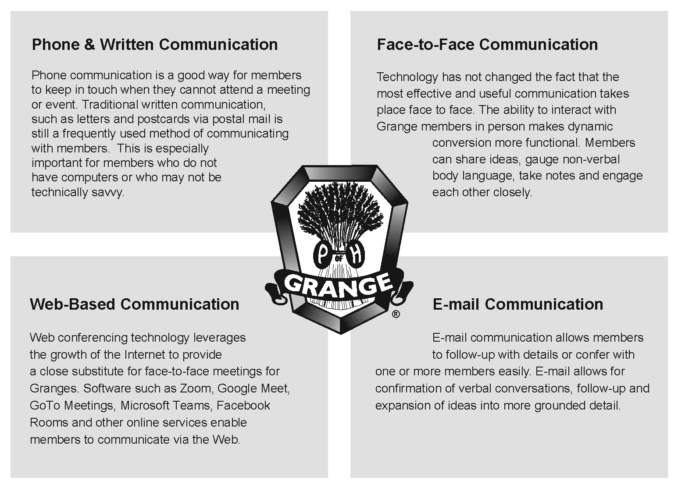

Slide 36
Ideas for Improving Member Communications
Use paper and/or electronic newsletters to share what’s going on and recognize members’ efforts.
Use Internet tools like websites, Facebook, Instagram, Twitter, or Google Calendar to let people know about meetings and upcoming events.
Send birthday cards to members, to let them know you think of them as individuals, or get well soon cards and thinking of you cards to those unable to attend meetings and events.
Let members know they were missed via a phone call or visit when they have been absent from meetings.

Slide 37
Ideas for Improving Member Communications
Even if they aren’t looking for a reward or recognition, members like to feel appreciated. Honor and recognition are good ways to help keep your members returning year after year. Members should be recognized throughout the year with words of appreciation, or more, for the time and energy they are giving to the Grange.
Write thank-you letters to speakers and all those who contribute time, effort, or money to Grange activities (both members and non-members). Present a token of appreciation if appropriate.
Ask members about connections they may have within the community, such as editors, station managers, mayors, school superintendents, and other public officials or personalities, then extend invitations for them to visit meetings and get acquainted with your members.

Slide 38
Ideas for Improving Member Communications
Develop (or purchase) Grange merchandise to show pride - such as clothing like T-shirts, jackets, polo shirts and sweatshirts, Grange jewelry, tote bags, and other items.
Be sure to welcome new members and guests into your Grange home.
Ask for member feedback - then listen. If members know they are contributing to the planning as well as the implementation, they will feel as if they are making a difference.
Generate enthusiasm. Host meetings and events that are well-planned, organized and friendly, so that they appeal to the members in attendance and the general membership.

Slide 39
Hosting & Promoting Events
Although planning an event can be daunting, there is a reason many organizations rely heavily on them – they can be incredibly successful.
When done well, both virtual and in-person events of all shapes and sizes have the ability to raise awareness, and funds, for your Grange.

Slide 40
Hosting & Promoting Events
Brainstorm new and creative ideas
Select a date/time/place
Assign responsibilities and/or committees
Set schedule/program details
Execute responsibilities/duties
Advertise/publicity/promotions
• Follow up

Slide 41

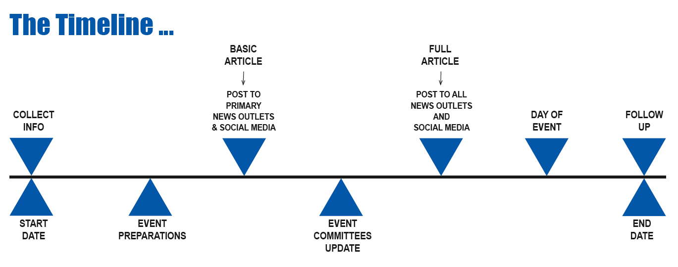

Slide 42
TIPS: Hosting & Promoting Events
The most important piece of your Grange event planning is your members. Give Grange volunteers as much time as possible to complete critical tasks. By avoiding the rush and stress that comes with last-minute planning and execution, you’ll achieve higher quality work and a better event (and happier members).
Make sure your potential attendees know about your Grange event before their calendars fill up! The earlier you start planning your event, the sooner you can start promoting it.
After you decide on an event concept – or if you have an existing concept from previous years – you ought to pick a theme. Your theme should make sense with the event concept and it should also be seen through your decor, your promotional materials, and even your program itself.

Slide 43
TIPS: Hosting & Promoting Events
Planning events takes time, but they can be well worth it. Make an event planning checklist to help you plan a successful event that will raise both funds and awareness for your Grange.
Your work doesn’t end when your event does. As soon as possible after the event wraps up, send thank you messages to your volunteers, your vendors, your entertainers, and – of course – your donors and even event attendees if appropriate.
By showing your gratitude, you will continue to build these important relationships and better ensure that each will support your Grange again.

Slide 44
Thinking Outside the Box
There are old Grange standbys you know will work: dinners, auctions, plant sales, tag sales, craft fairs, etc. Your Grange has done all of these before, and you know they’ll help you Grange stay afloat. But running the same old events year after year can get old, for you and for your community audience.
It’s time to think outside the box!

Slide 45
Thinking Outside the Box
Nothing is out-of-bounds for ideas
Consider every suggestion offered
Put a twist on an old-standby event
Make a statement towards your purpose
Prioritize a list of creative ideas
Move forward not backwards
Don’t be afraid to try new things

Slide 46
Ideas, Ideas, Ideas
Events and activities are a great way to engage supporters, promote your cause, and have a ton of fun all at once.
Creative ideas can help you get the ball rolling on membership recruitment, fundraising, longer-term initiatives, overcome a financial slump, or quickly collect resources in response to something unexpected. The effectiveness of your ideas depends on how well they engage members and volunteers, maximize community participation, motivate immediate action, and inspire donors to show their support.

Slide 47
Ideas, Ideas, Ideas
Here’s a few “Outside the Box” ideas…
Afternoon Tea / Ice Cream Social
Trivia Night / Game Night / Casino Night
Community Garden / Window Box Herb Garden
Bowling Tournament / Softball Tournament
Bookworm-a-Thon / Book Club
Best Pizza / Best Chili / Best Meatballs / Best Sandwich Competitions
Salad Bar and Yoga Dinner
Tour Around the World - Dinner and Slideshow
Super Souper Bowl (football & soup)
TV Show Viewing Party with Theme Refreshments

Slide 48
In conclusion…
Promoting your Grange encompasses a range of considerations. In addition to the regular concerns of how to market your Grange effectively, Granges must also worry about how to do so on a budget. In this presentation, we’ve given you a head start on your promotional and marketing strategies. Remember:
Set a realistic and attainable goal
Plan ahead and make a to-do list
Know your members and your audience
Continual communications / contact
Utilize technology and the internet/social media
Include interactivity with members and the community
in Grange marketing & promotions
Make the effort and take the steps to succeed

Slide 49


