Slide 1
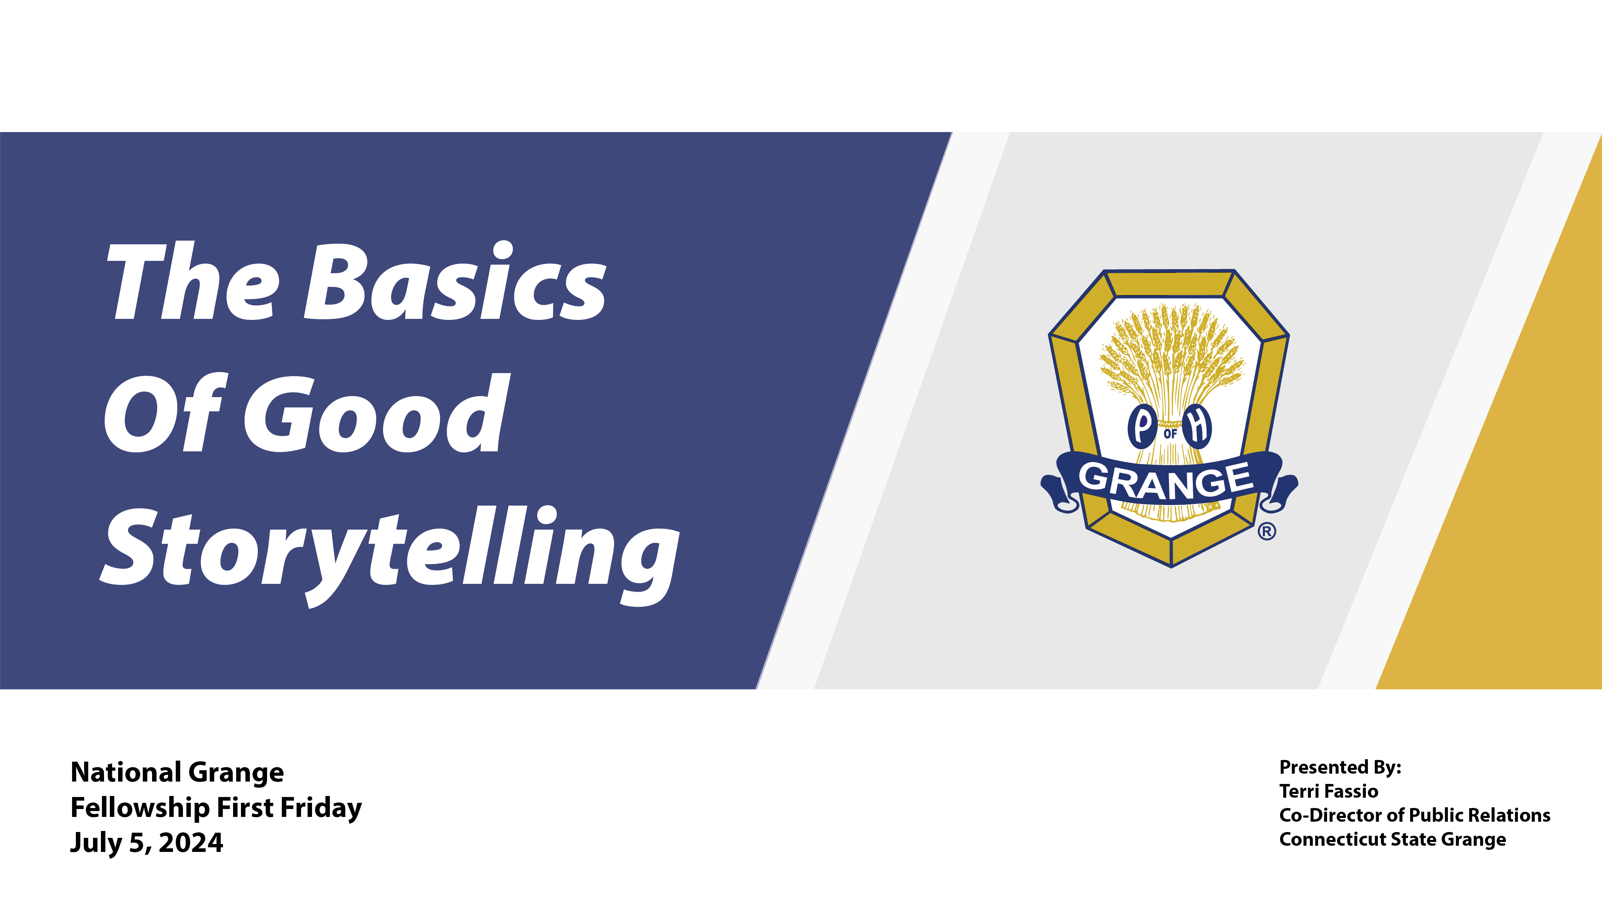

Slide 2
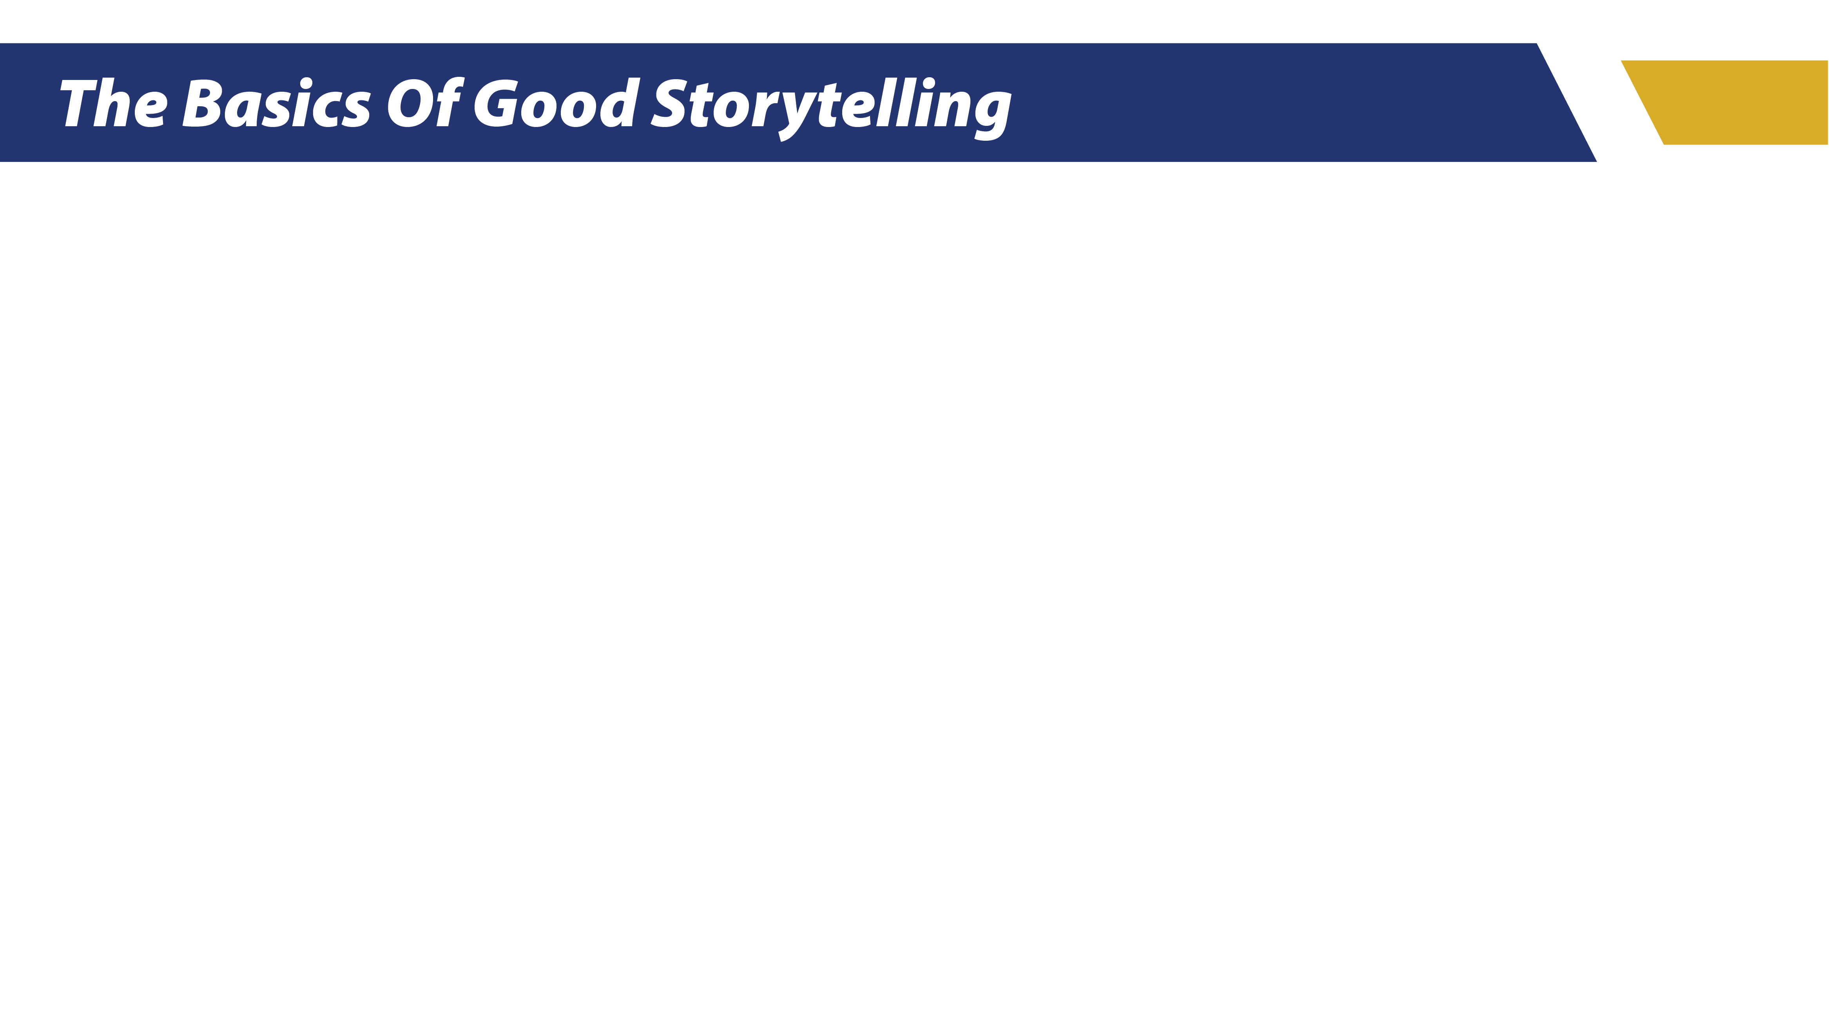
Stories have stood the test of time. Storytelling is one of the most ancient art forms, with history’s oldest known story dating back to the third millennium B.C. It’s both an art and a science, and a way of creating a deep connection with one person or a million people.

Slide 3
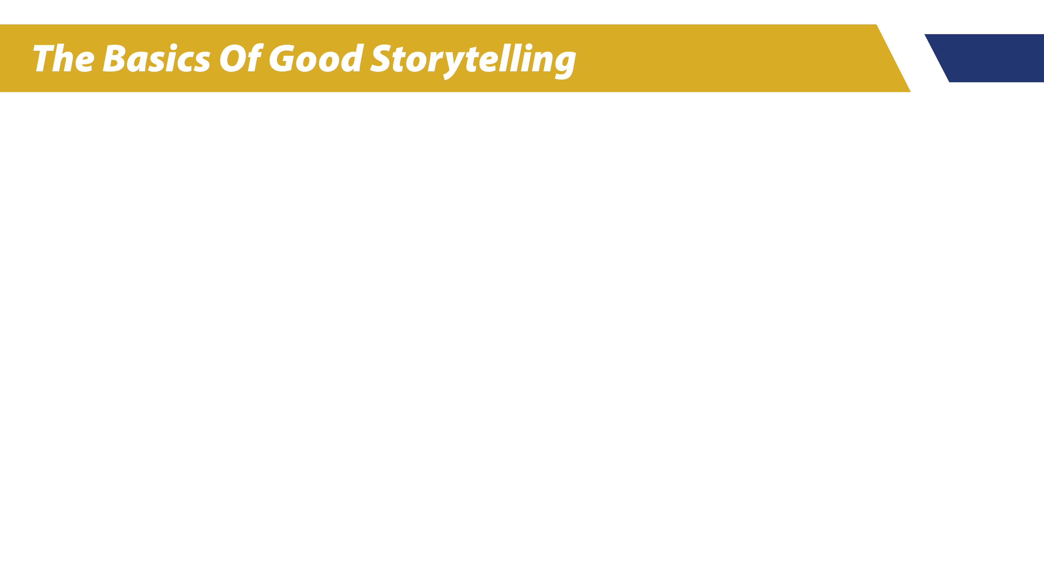
Through stories, we feel that inherent connection to the storyteller, to the characters, and to the heart of the story.
There are 5 main parts to every story --

Slide 4
1.) PLOT
The plot is the events or actions that drive every story — it describes the “what” of your tale. The plot lets the reader know what’s happening, describes the problems the characters are trying to solve, and gives the details on how they attempt to solve them.

Slide 5
2.) SETTING
The setting of the story is both the physical location and point in time in which the plot takes place. Modern-day New York or civil rights era Mississippi? Victorian England or New Jersey in the 1980s? Or even this year? There are so many places to travel to, and so many interesting times to draw from.

Slide 6
3.) CHARACTERS
The characters are the people, animals, beings, or personified objects driving the story. A story can have many characters or just one main character as the focus. Each story’s characters should be compelling. It is important that the reader invests and cares about the character's journey.

Slide 7
4.) POINT OF VIEW
Point of view (or POV) describes the lens through which the story is being told. There are several different POVs to consider, but the most common are first person, second person, and third person.

Slide 8
5.) CONFLICT
Conflict is the big problem or issue of the story. What are the characters trying to overcome? There can be one major conflict in a story, or the characters may encounter several throughout the tale. But more than likely there is one big theme driving the conflict. The most common types of conflict are: character vs self, character vs character, character vs nature, and character vs society.

Slide 9
Whether you realize it or not, these points are naturally included when telling a story. It’s what creates the story’s flow and structure, builds direction and anticipation, and excites listeners/readers.

Slide 10
What makes a great storyteller?
• Energy
• Enthusiasm
• Confidence

Slide 11
What makes a great storyteller?
• Listening
• Interacting

Slide 12
What makes a great storyteller?
• Inspiration
• Vulnerability
• Authenticity

Slide 13
What makes a great storyteller?
• Creativity
• Empathy

Slide 14
What makes a great storyteller?
• Clarity
• Personal Experiences

Slide 15
So, how does this relate
to the Grange?

Slide 16
Every Grange has a story that helps to inform others of its purpose, mission, and vision. The better that story is told, the more likely it is that the Grange will receive the attention, support, and resources it needs to achieve its mission. Storytelling makes it personal and transforms the heart and mind of the Grange’s audience by showing them why the Grange is important, instead of just telling them.

Slide 17
Storytelling puts a spotlight on the people who have been most directly impacted by the Grange's efforts, such as someone whose life has changed through volunteering, a student who was able to continue their education because of scholarship funds, or a member who is a cancer survivor and hopes to see funding for a cure. These are the impactful stories that leave the biggest mark.

Slide 18
Stories Stick With Us

Slide 19
While a potential member may not know your exact Grange mission, they will remember the video they saw telling the story of a local family experiencing job loss and food insecurity who found resources from your Grange food collection.

Slide 20
Storytelling has the unique ability to connect with the people who care about the Grange mission on an emotional level, helping them understand the impact of their membership and contributions, and inspiring them to support the Grange.

Slide 21
Fellowship First Friday • July 5, 2024

