Slide 1

Zoom Refresher Course
Virtual Social Hour
Connecticut State Grange

Slide 2
Zoom Plans
There are 4 Zoom Plans Available:
Basic: Free – Host up to 100 participants (40 minute limit) + unlimited one-on-one meetings (30 minute limit) + screen sharing + local recording + scheduling.
Pro: $14.99/month per host – Includes all “Basic” features + usage reports + no time limits + 1 GB cloud storage.
Business: $19.99/month per license (minimum 10 licenses) – Includes all “Pro” features + supports up to 300 participants + admin dashboard.
Enterprise: $19.99/month per license (minimum 50 licenses) – Includes all “Business” features + supports up to 500 participants + unlimited cloud storage.

Slide 3
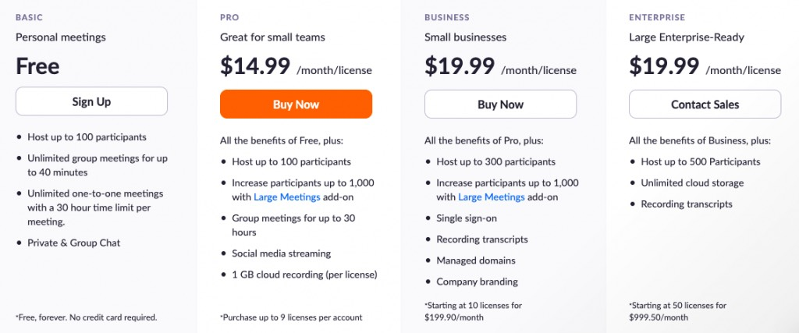
Zoom Plans

Slide 4
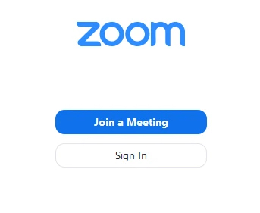
Do I Need A Zoom Account?
To be a meeting participant, a Zoom account is not required. Participants can attend meetings as guests. To host a meeting, to be specifically invited by email to a meeting, or to be assigned to a breakout room prior to the meeting, a Zoom account is required.
To host a meeting longer than 40 minutes, a Pro Account is required.

Slide 5
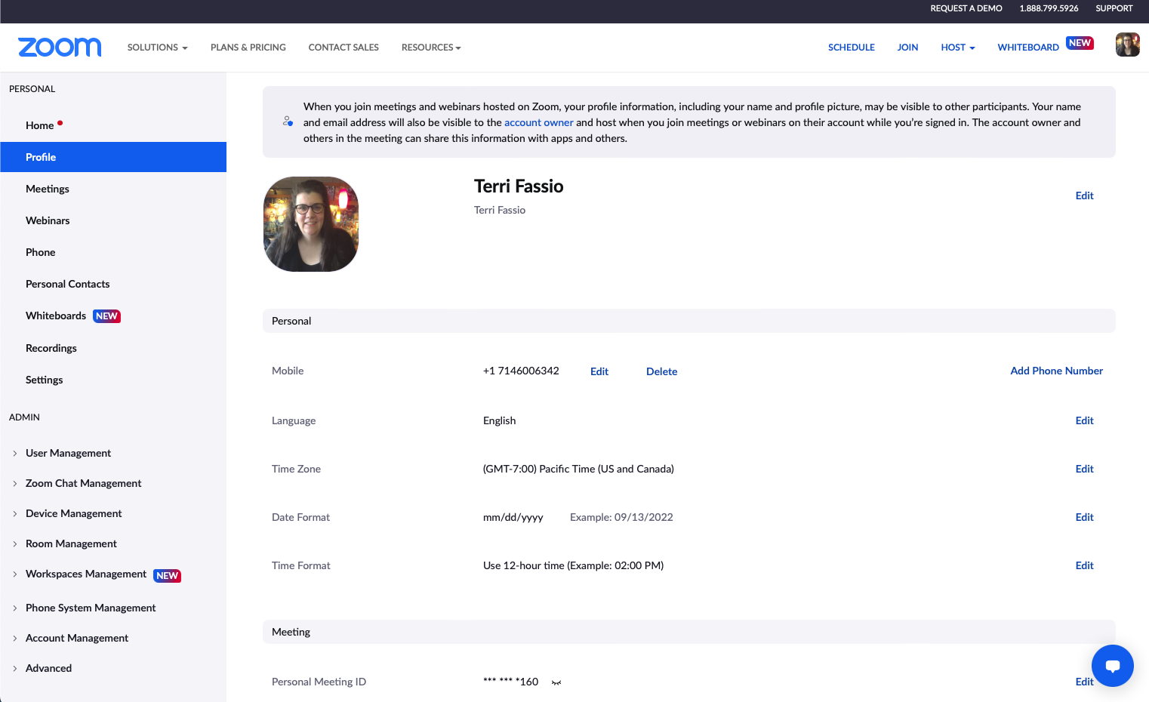
Setting Up Your Zoom Profile
To sign up for your own free account, visit the Zoom sign-up page and enter your email address. You will receive an email from Zoom (no-reply@zoom.us). In this email, click Activate Account.
You can sign in to your Zoom account on the web at any time, at zoom.us/signin. Once you're logged in, use the panel on the left side to navigate the Zoom web portal. You can update your profile, schedule a meeting, edit your settings, and more.
You can download the Zoom Desktop Client for Mac, Windows, Linux, and ChromeOS, as well as the Zoom Mobile App for iOS and Android, from Zoom's Downloads page.

Slide 6
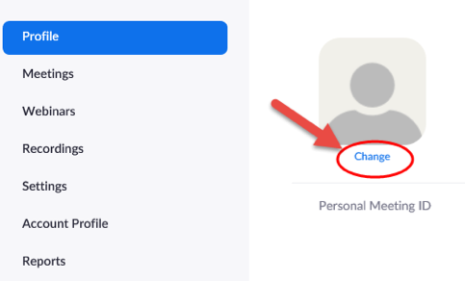
Setting Up Your Zoom Profile
Zoom allows you to personalize your account profile with a photo, which will appear in the Participants display during a meeting. Photos should be less than 2MB in file size and Zoom accepts JPG, GIF and PNG file types.

Slide 7
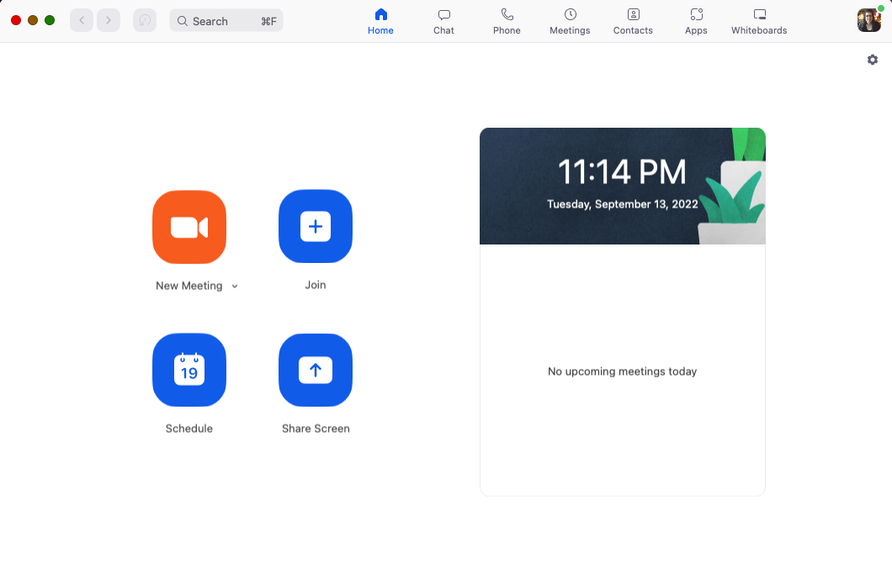
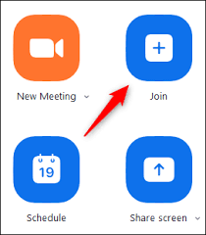
How to Join a Meeting
There are many ways to join a meeting, but the easiest way is to click the join link that the meeting host provided.
You can also click Join in your Zoom client and enter the meeting ID.
You may also be prompted for a meeting passcode, so keep the meeting invite information available.

Slide 8
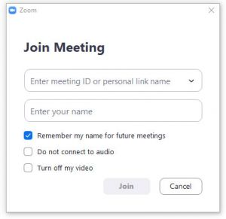
How to Join a Meeting
You may see this window to the right when joining a meeting. Enter your name as you would like others to see you - and then check the box to remember your name for future meetings.

Slide 9
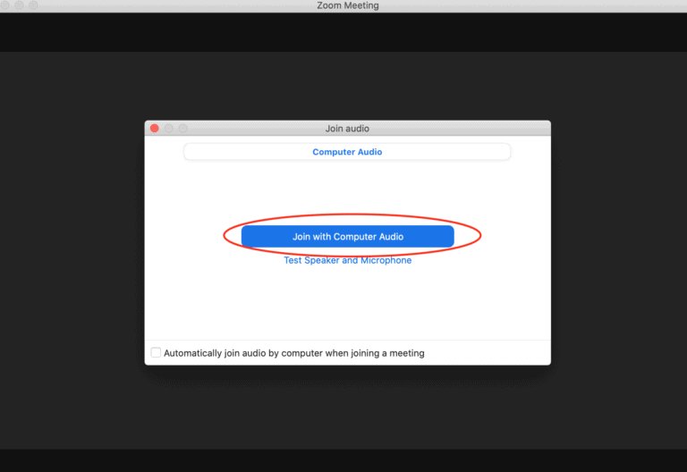
How to Join a Meeting
When joining a meeting, you have the option of joining with Computer Audio, which means that you are NOT muted when entering the meeting.
On this screen, you can also select the option to test your audio (speaker and microphone) prior to joining the meeting.

Slide 10
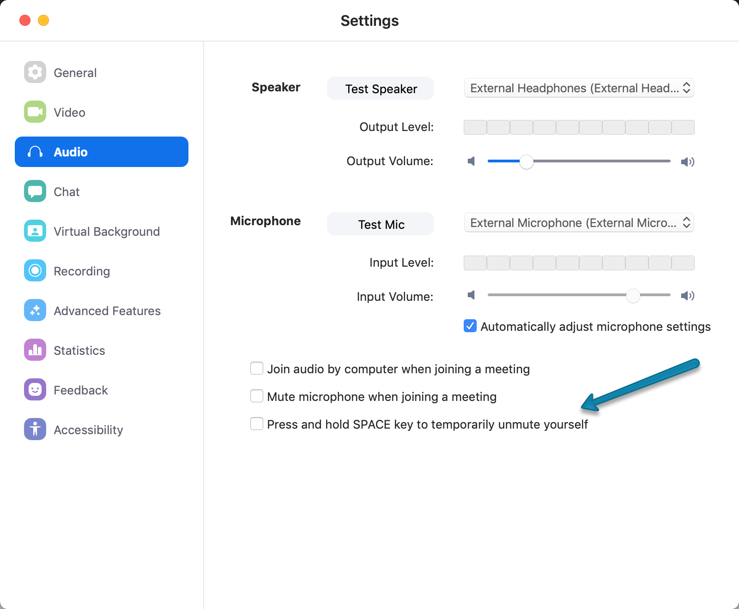
How to Join a Meeting
Audio - Microphone Test
When speaking into the microphone, the input level will show as you speak. You can adjust the input volume by sliding the Input Volume slider found under the Input Level.
If testing your microphone, it is wise to suppress the background noise.
Pro Tip: Mute and unmute using the space bar shortcut. This must be turned on under the Audio Settings.

Slide 11
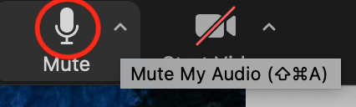
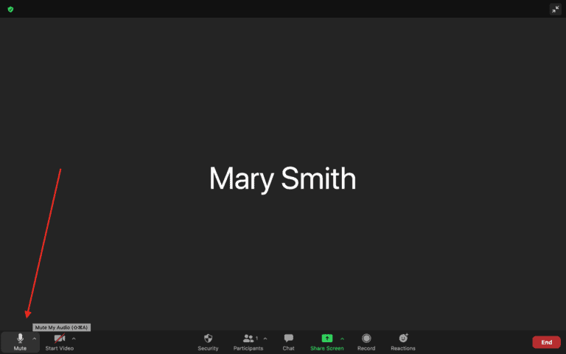
Audio Settings
The Microphone Icon
Audio settings are found under the microphone icon. It is green when on, and has a red line through it when muted. There is a little arrow next to the microphone, which contains more settings, such as selecting your microphone, and your speaker, and allows you to test both to be sure everything is working.

Slide 12
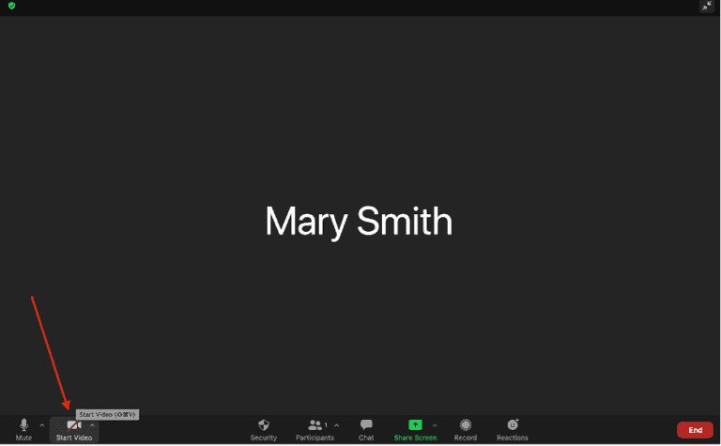
Video Settings
The Video Camera Icon
This is the little video camera icon on the lower left. Click to toggle turning the camera on and off. If the video is off, then only your photo avatar appears in the window if you are logged into an account, or your name appears in the window if you are not logged into an account.
There is a little arrow next to the camera with additional video settings, such as changing the camera if you have multiple cameras, setting a virtual background, testing your camera and more.

Slide 13
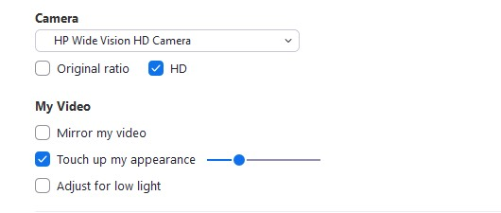
Video Settings
Pro Tip: Under the additional video settings, you can touch up your appearance to add a softer look and smoother skin. To turn it on, click the up arrow next to Start Video. Click Video Settings, and under My Video, check the box for Touch Up My Appearance. Adjust the slider to smooth your appearance.

Slide 14
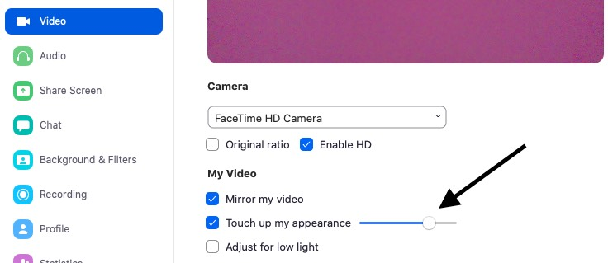
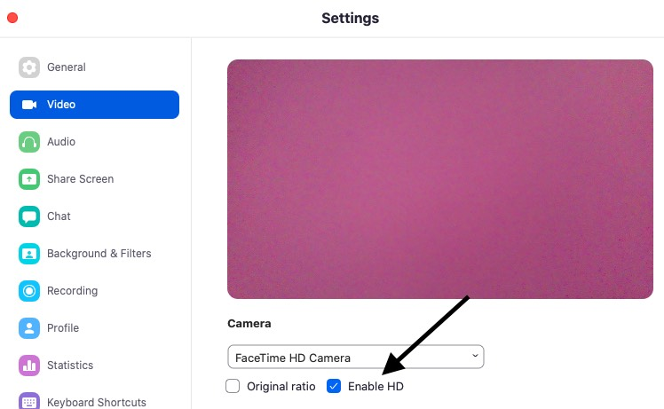
Video Settings
Pro Tip: Also under the additional video settings, there is a selection to mirror my video - which flips the picture so that it is properly facing to those looking at you.
Pro Tip: Set your camera to Enable HD. This will make sure that you fill the picture window, and do not have color bars on the sides of your windows.

Slide 15
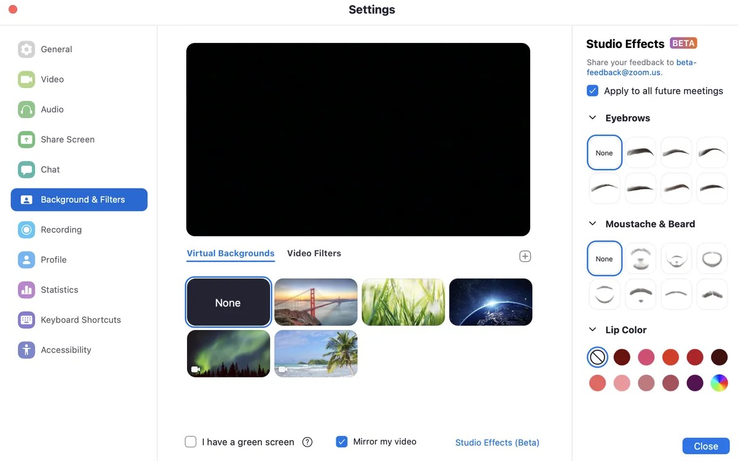
How to set a virtual background
There are certain computer hardware and software requirements to use the Virtual Backgrounds. You will need to be using the Zoom desktop app instead of Zoom in the browser. For PCs - you will need an i5 or better running a minimum of Windows 8, but preferably Windows 10 or better. For Mac, i5 or greater running macOS 10.13 (High Sierra) or higher.
Go to "Settings" arrow next to the start/stop video icon and choose "Virtual Background." You will be prompted to download a virtual background package -- just once -- and then you can try out different screens supplied or add your own image/video instead.
To add your own image, it must be a good enough resolution and size to look good. (1920x1080 pixels is ideal). Click the little plus sign on the right in the Virtual Background selection to upload your own image/video.

Slide 16
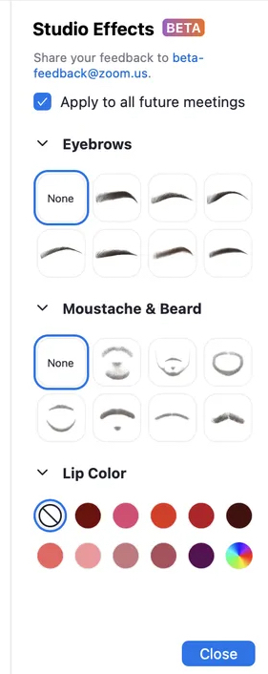
Video filters and effects
There are a number of fun filters available that you can add to your appearance, such as facial hair, unicorn horns, a pirate eye patch, cat ears, artistic borders and more. You can even change the color of your appearance. These are available under the "Settings" arrow next to the start/stop video icon and choose "Video Filters."

Slide 17
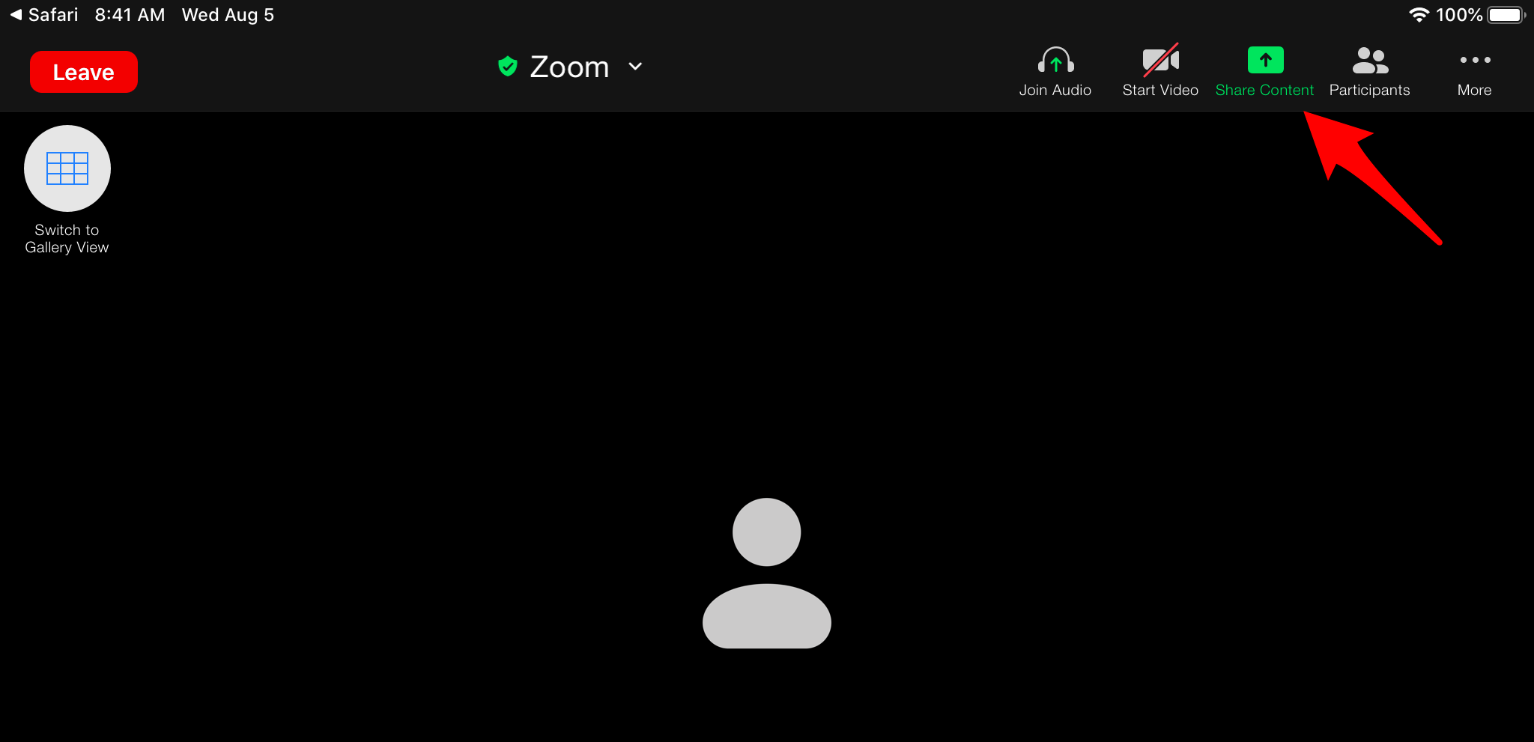
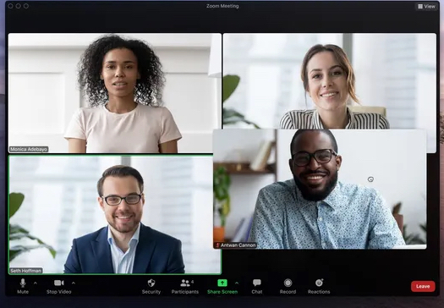
iPad vs. Smart Phone vs. Computer
Controls in different locations
The desktop version of Zoom offers much more control than the iPad/Phone versions. Especially if hosting a meeting, the host should definitely be on a desktop computer in order to have access to all of the controls.
The location of the controls is different in the iPad/Phone versions of Zoom versus the computer version. On the iPad, your controls are up on the top right of the window, while on the computer, they are down along the bottom of the window.

Slide 18
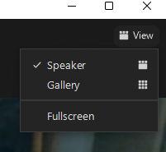
View Settings
(Gallery View vs. Speaker View vs. Immersive View)
This only impacts how YOU view a meeting on your own device, and does not affect others.
Gallery view lets you see everyone in the meeting at once, instead of just the person speaking. To turn that on, click the tab that says "Gallery view" in the top right corner. By turning on gallery view, you see up to 49 meeting participants at once.
If the meeting has 49 or fewer attendees, you'll see all of their screens displayed on one page. If there are more, you'll have the option to move between multiple pages.

Slide 19
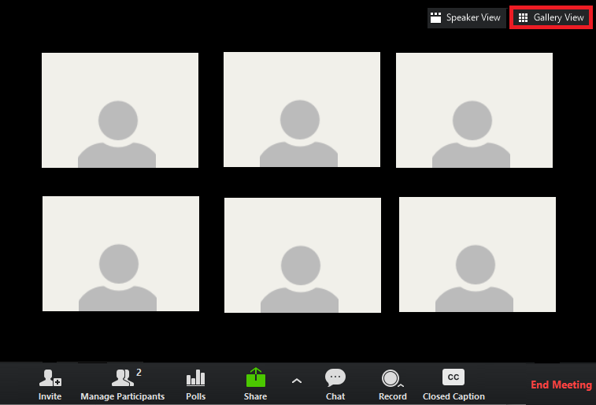
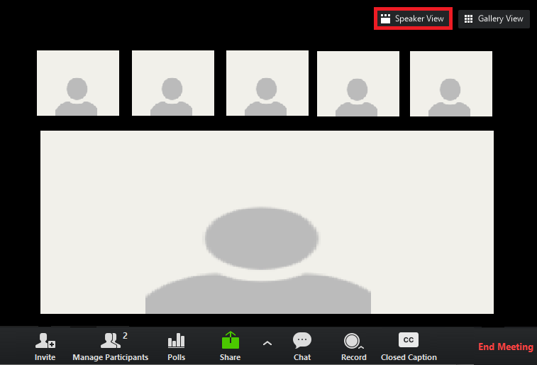
View Settings
(Gallery View vs. Speaker View vs. Immersive View)

Slide 20
View Settings
(Gallery View vs. Speaker View vs. Immersive View)
NOTE: The host can control the view when people are speaking to spotlight or pin certain people at specific times, which will effect the view on the attendee's device.
Pro Tip: You can customize your Gallery View. Click and drag attendees boxes to create a custom organization. After the first change, all other participant tiles will remain in place until moved. New participants will be added to the bottom-right, and on the last page if multiple pages are present. Your custom order will be seen only by you.
NOTE: The host can deploy a custom view order to all participants, but that order may be overridden by the user based on how the user's settings are defined.

Slide 21
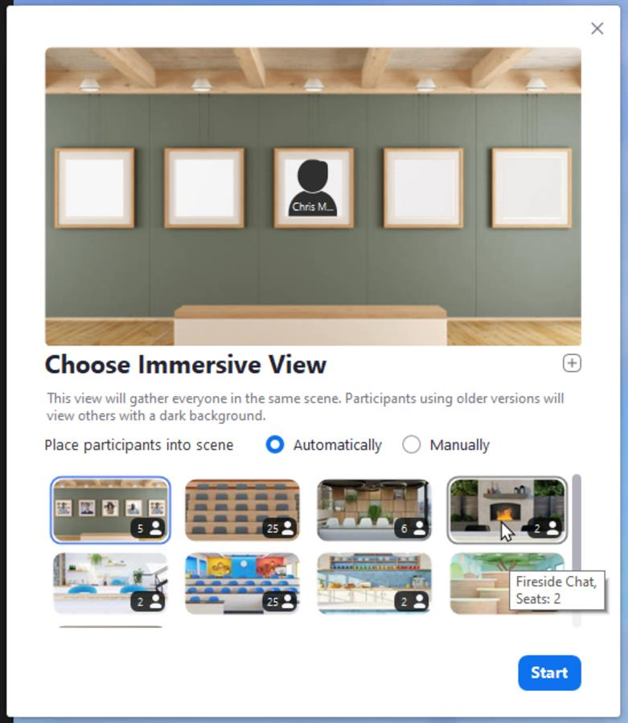
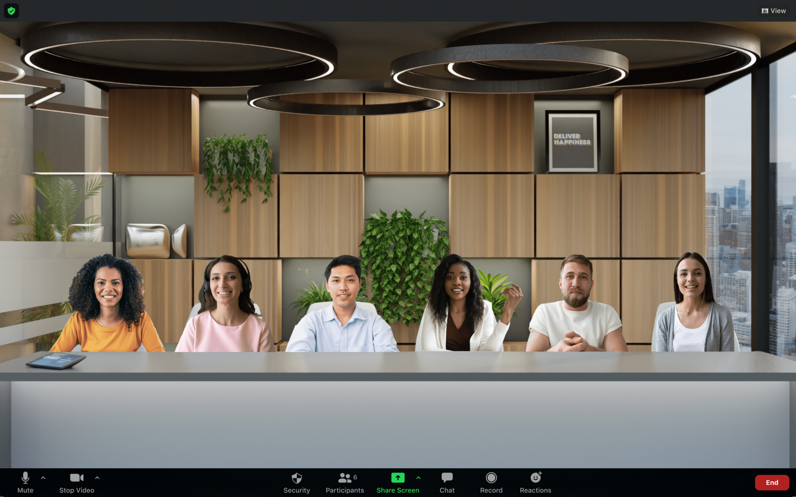
View Settings
(Immersive View)
Immersive View allows hosts to arrange video participants and webinar panelists into a single virtual background, bringing people together into one scene to connect and collaborate in a cohesive virtual meeting space.
Whether you want to create the feeling of being in a classroom, a boardroom, a conference auditorium, or your favorite place to catch up with friends, Zoom’s Immersive View assembles up to 25 participants in one fun, consistent meeting environment.

Slide 22
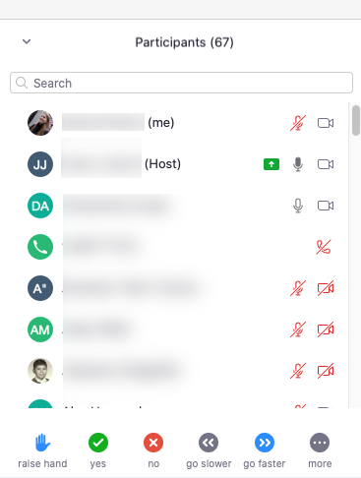
Participants Window
Clicking this option will bring up a box with everyone connected to the meeting. Click the participants icon at the bottom of the screen and the box will appear on the right.
NOTE: If you are on an iPad, tap participants in the meeting controls, and the box will appear. The box is not permanent like on the desktop version, and will appear to overlay the main window.

Slide 23
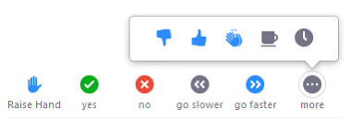
Participants Icons
There are a number of icons available to users to communicate with the host and other users without disrupting the meeting flow. Once an icon is selected, all participants can see the all icons that everyone else has chosen. In addition, the host sees a summary of how many participants are displaying each icon. The icons are as follows:
Raise Hand / Yes / No / Go Slower / Go Faster / More (thumbs up (agree), thumbs down (disagree), clapping hands, Coffee cup - need a break, clock - meaning away from your seat).
When an icon is selected, the icon will appear next to your name until removed (clicked on again) by the user or cleared by the host.
NOTE: The Raise Hand icon, while located near the other non-verbal icons, is controlled differently from the host's perspective.
NOTE: If you are on an iPad, go to more on the top menu bar, then clock one of the icons to provide feedback. Click the icon again to remove it.
NOTE: Each person can only have one icon active at a time

Slide 24
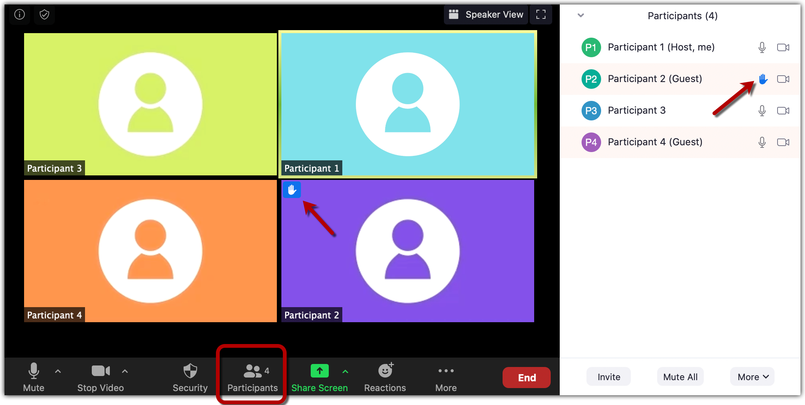
Participants Icons
Raised Hand Icon
If you have raised your hand, you will find the icon beside your name in the participant's list.
Note: If you are participating by calling in on the phone, you can raise your hand by dialing *9. To lower your hand, dial *9 again.

Slide 25
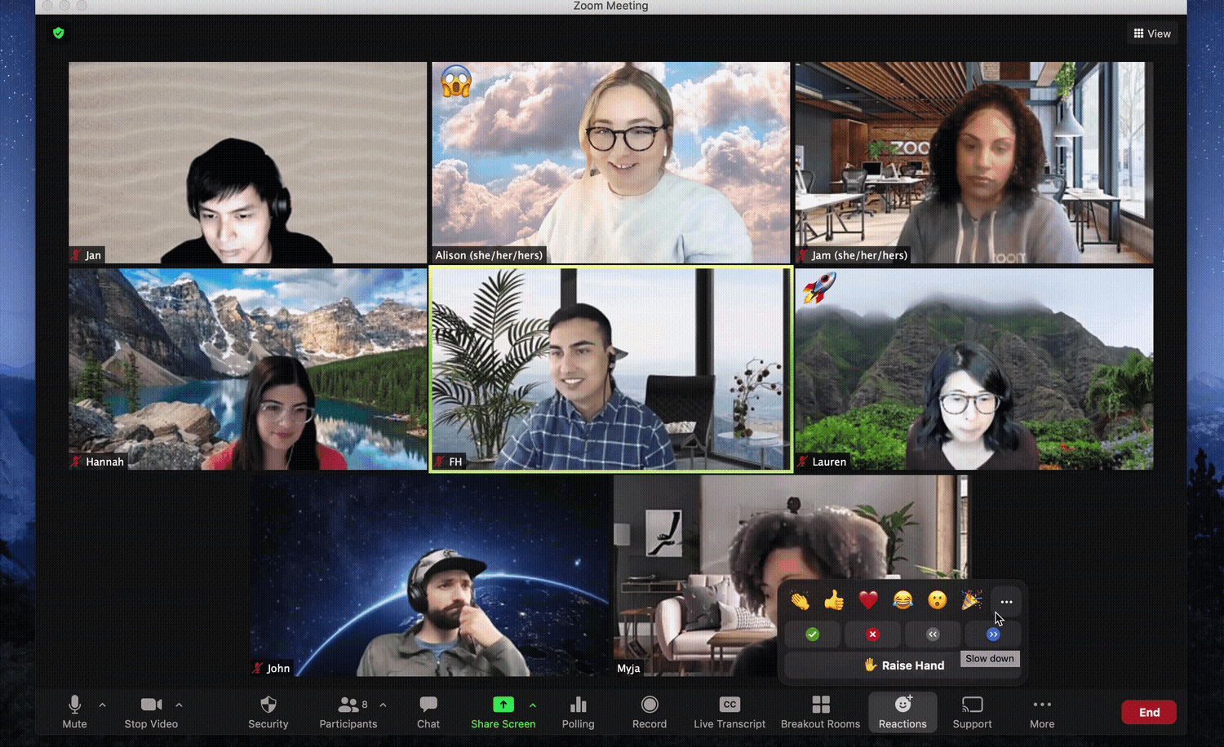
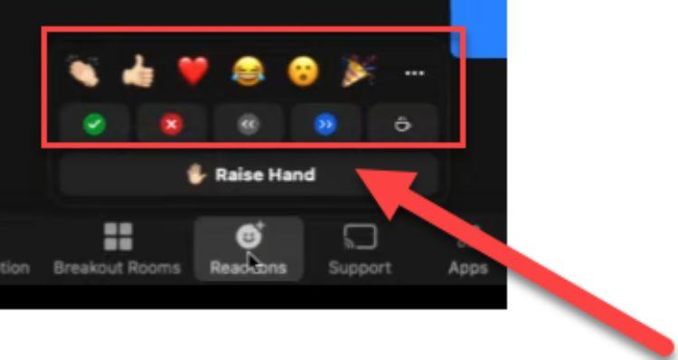
Reactions
Reactions are slightly different than Participants Icons.
At the bottom of the window is a reactions icon. When you click this you will see 6 different reactions - clapping hands, thumbs up, a heart, a crying laughing smile face, a shocked/wow face icon, and a cone of celebration confetti. When selected, these appear in the corner of your photo.
Reactions still work when muted
Reactions disappear after a few seconds
There is a short cut to the Raise Hand option under the Reactions window.

Slide 26
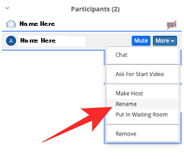
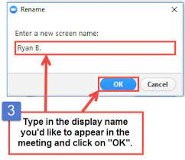
How to change your display name
Click on the participants icon on the bottom of the screen. A sidebar will open with a list of people who are in the meeting. Find your name (or number in some cases) in the list. There is a more button to the right of your name. Click that button. Then select “Rename”. A dialog box will pop up where you can type the name you want to use. There is also a check box to Remember the name for the the future. Be sure to click that too. Click ok. Then your new name should appear.

Slide 27
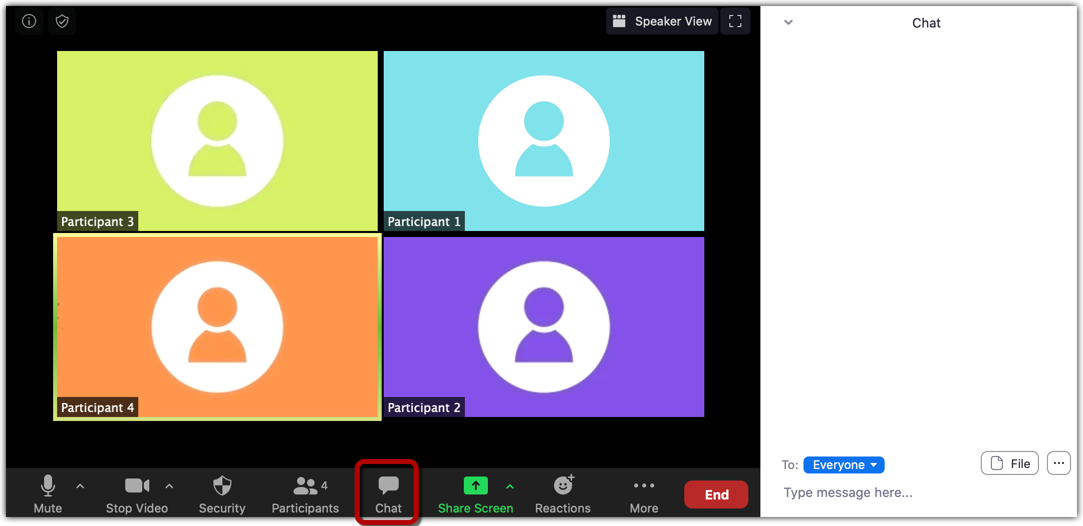
Zoom Chat
Chat is an easy way of conversing with the participants of the meeting via text messages.
Click the Chat icon on the lower menu bar. When clicked, it opens a chat window on the side. Chat is available unless the host has disabled the function for the meeting. The host can also set limitations on chat, so that attendees can chat with everyone, with only the host or with a specific set of attendees.

Slide 28
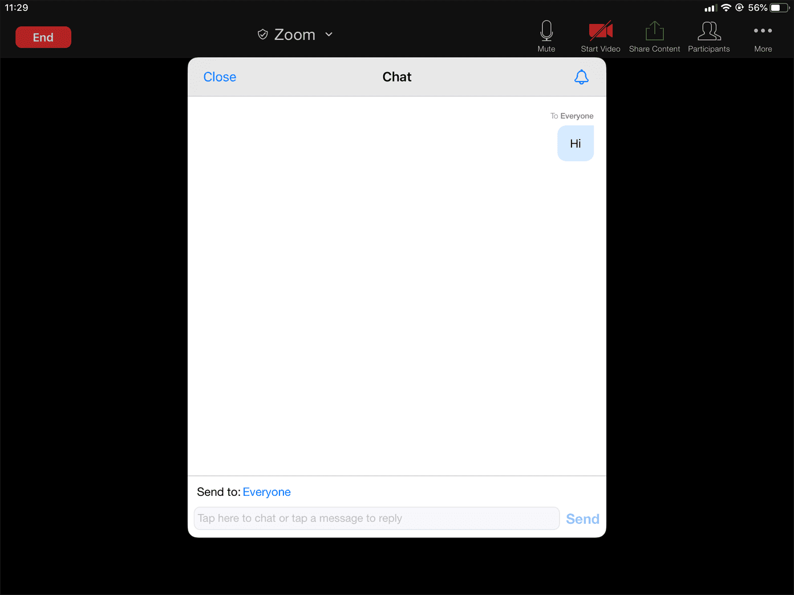
Zoom Chat
NOTE: If on an iPad, tap participants, then at the bottom of the list tap Chat. Type your message and tap Send. If you want to send to a specific person, tap the arrow next to "Send to:" and choose from the list. When new chat messages are sent, they will be displayed at the bottom of the screen. Tap Participants, then Chat to view them.

Slide 29
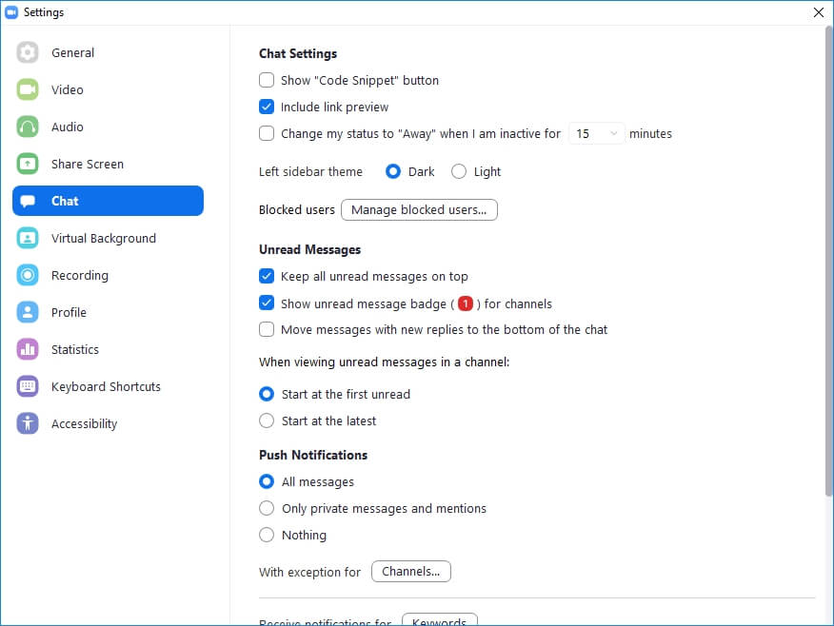
Zoom Chat Settings
If you click the gear icon in the top right corner of the Zoom window, you can access your settings. If you go to "chat" in the left menu bar, a window opens with all the chat settings.
Here you can decide how you want your messages to appear, whether or not you receive push notifications for messages and hear sounds for new messages, and it is also where you can change your status from active to away when you are inactive for a set period of time. If you have notifications set-up on your computer, this is also where you can mute those during a meeting.

Slide 30
Zoom Chat
How to send a message via chat / to everyone vs. private: You can send a message to everyone in the chat or send a private message to one of the participants. You can also mention participants while typing a message.
To mention someone - use the "@" sign and then start typing the person's name. Their name will appear in the list for you to choose
Pro Tip: You can also share files via chat.

Slide 31
Zoom Chat
The host cannot see private messages that the participants send to each other during the meeting session itself. However, if the Zoom meeting is recorded, the chat is recorded along with it. If that recording is shared, then the chat is shared as well.
It’s probably best to avoid sending potentially sensitive private messages on Zoom Chat if you’re sending messages you want to stay private.
It’s also easy to accidentally send a message publicly instead of privately, and most people don’t understand the finer points of how Zoom records private messages along with public ones.

Slide 32
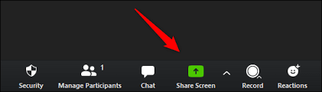
Screen Sharing
To share your screen, click the Share Screen icon on the toolbar at the bottom of the meeting screen. It is green. You'll have the option to share your entire desktop, part of your screen, or just one of the windows/programs you have open.
Once a screen is shared, the controls are in a green and red bar at the top of the window, and that screen is a floating screen that can be moved around.

Slide 33
Screen Sharing
For added functionality, there is also a file-sharing tab under "share screen" (shown under "Files"), which includes application links to Dropbox, Microsoft OneDrive, Google Drive, and Box
Pro Tip: The host can take control of a participant's screen if allowed to do so by the participant. The host can also disable participants' ability to share their screen.

Slide 34
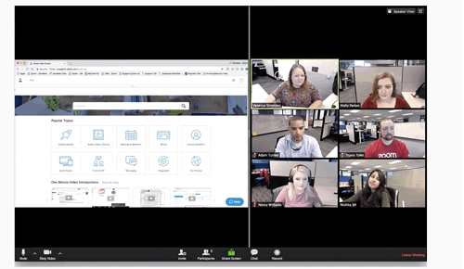
Screen Sharing
Side by Side Mode
If you are viewing a shared screen, you can switch to Side by Side mode to see the shared screen alongside either the Speaker View or Gallery View, depending on which view is choosen. You can also adjust the location of the separator between the shared screen and video to change the relative size of each side.
NOTE: The setting is located under View Options once a screen is shared. Choose “Side-by-Side Mode”. This will be located at the top of your zoom screen. The shared screen will appear on the left and the speaker will appear on the right. Slide the separator to the left or right to adjust the size of each view.

Slide 35
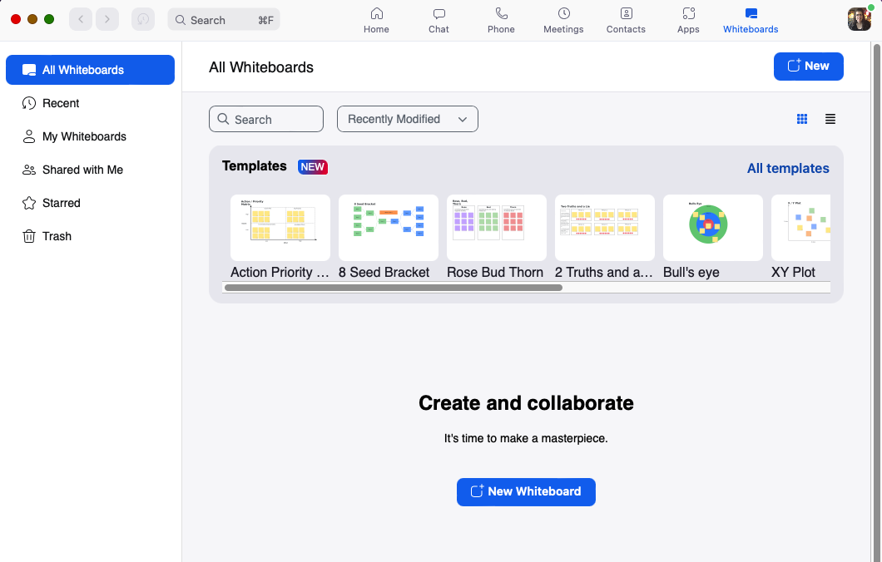
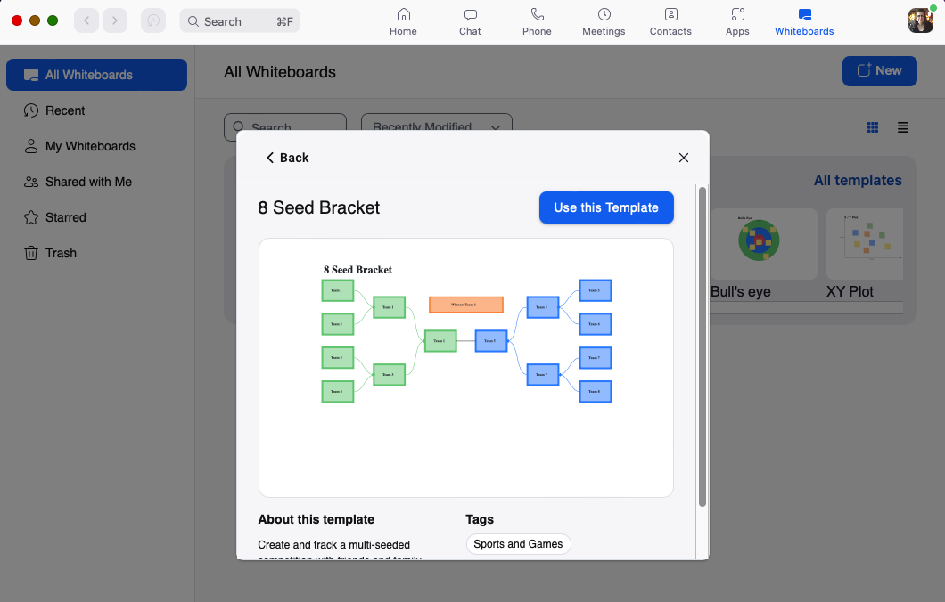
Whiteboards
Zoom has a Whiteboard feature that allows you to share a whiteboard that you can annotate on with others. The whiteboard is a handy tool for hangouts, presentations, and even game nights. To use this function, click on the green Share Screen icon, then select the Whiteboard and click Share. Once you click on the Whiteboard, templates and the annotation tools will become available. The annotation tools include the ability to use text, a draw tool that lets you draw something freehand or use shapes, a stamp tool, a spotlight tool for presenting to your viewers, and an eraser.
If the option is turned on by the host prior to the meeting, (under Meeting Controls) then everyone in your meeting can interact with and add to the whiteboard. This makes it easy to create a Pictionary game, to collaborate on ideas and projects, or hangout with a virtual drawing board.

Slide 36
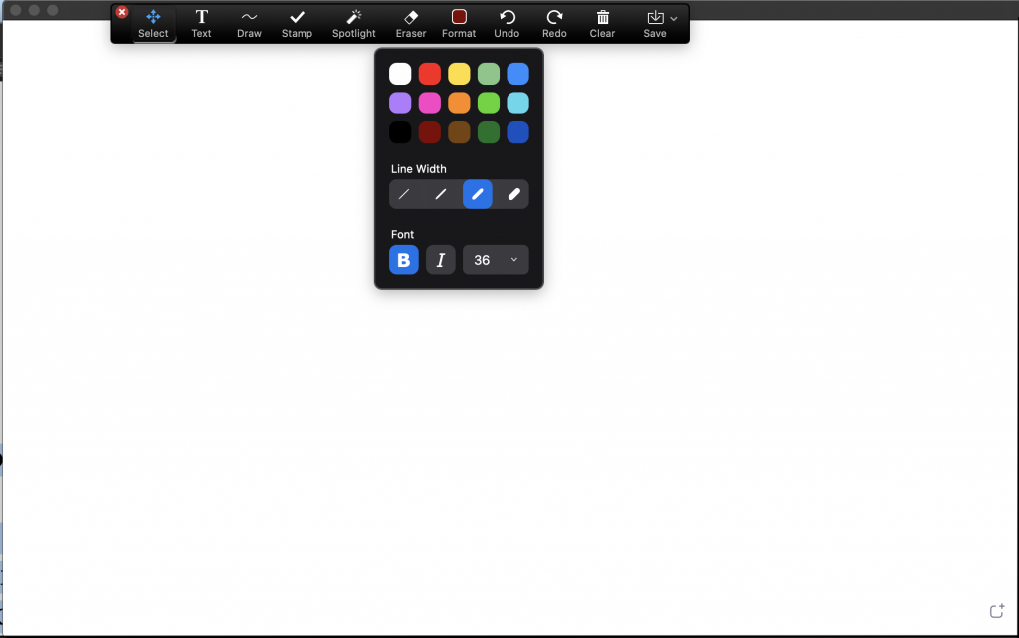
Whiteboards
The page controls in the bottom-right corner of the whiteboard are where you create new pages and switch between pages. Only the participant or host that started sharing the whiteboard has access to create and switch pages. When you are done, click Stop Share.
NOTE: You will also see an option to save your whiteboard screen for later reference, but the only person who can save the whiteboard is the person sharing their screen.

Slide 37
Zoom Polls & Surveys
Zoom has a built-in polling feature that handles both pre-planned polls and
in-meeting polls.
While the terms are interchanged, there is a difference between a poll and a survey.
A poll is used to ask one simple question while a survey is generally used to ask a wide range of mutliple questions.
A poll allows you to ask one multiple choice question. Participants can choose from among answers that you predefine.
When creating pre-planned polls on Zoom, this allows for matching, ranked order, short answer, and long answer questions. This is often considered a survey as there are multiple questions.

Slide 38
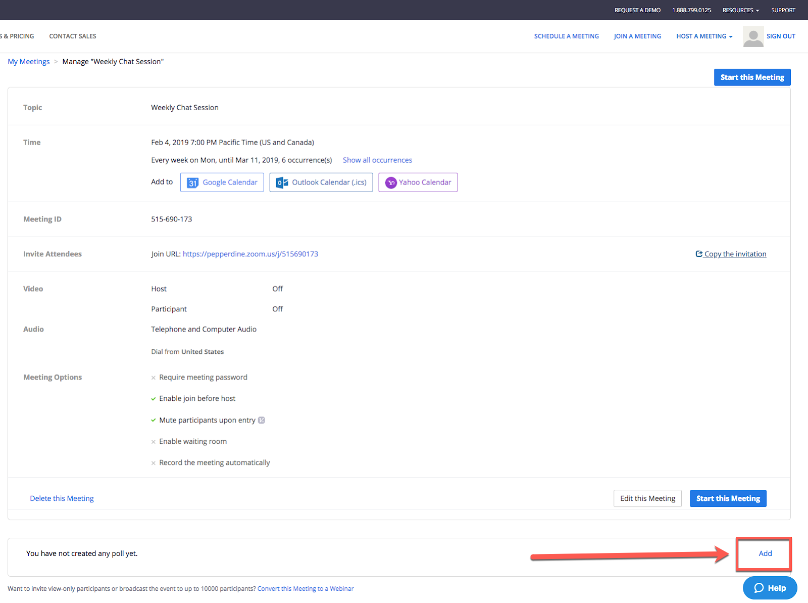
Zoom Polls & Surveys
Creating a Pre-planned Poll:
  Go to a scheduled meeting under the meetings tab
  Scroll to the bottom of the meeting invitation, click “Add” to begin creating the poll.
  Title the poll, enter question type (single or multiple choice), and click “Save.”

Slide 39
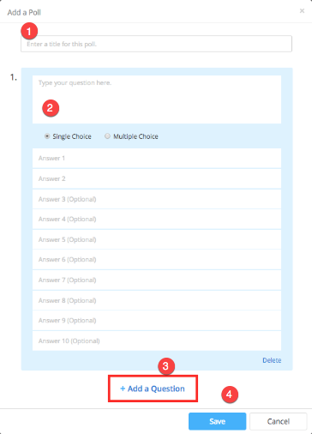
Zoom Polls
Creating a Pre-planned Poll:
  Title the poll, type your question and answer(s), enter question type (single or multiple choice), and click “Save.”

Slide 40
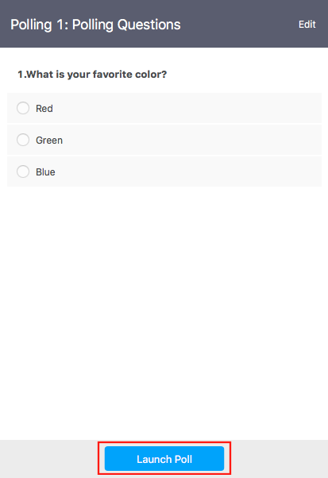
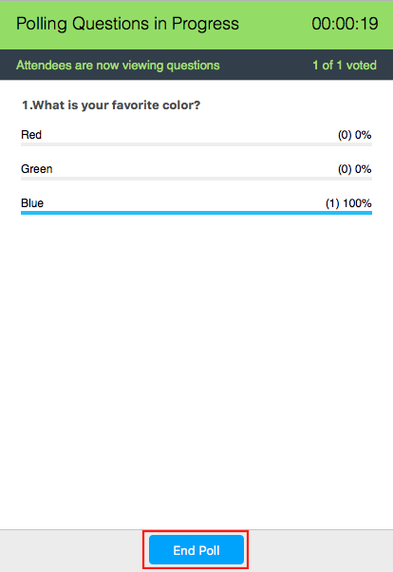
Zoom Polls
Launching the Poll:
  Click “Polling” in the bottom toolbar, then click “Launch Poll.”
  Participants in the meeting will be prompted to answer the polling questions. Once an answer has been submitted, the host will be able to see the live results.

Slide 41

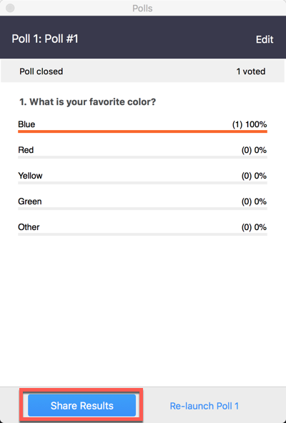
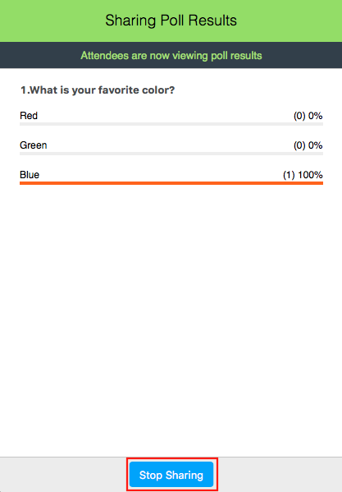
Zoom Polls
Launching the Poll:
  When finished with the poll, click “End Poll.”
  To share polling results with meeting participants, Click “Share Results.”
  Click “Stop Sharing” to stop sharing poll results with meeting participants.

Slide 42
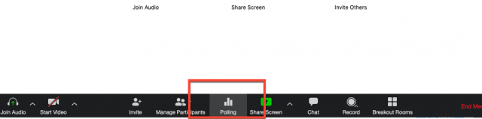
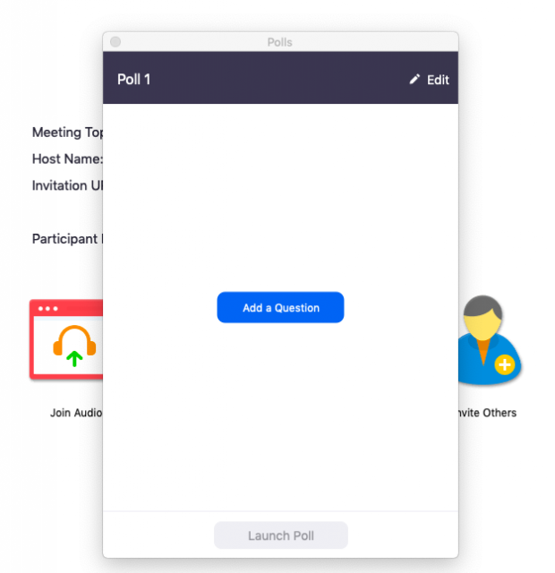
Zoom Polls
Creating an In-Meeting Poll:
  You can also create a poll by clicking Polling during the Zoom meeting.
  This will open up your default web browser where you can add additional polls or questions. Click “add a question” and then navigate to the page that will appear in your browser, where you can create a question to be used in your meeting.

Slide 43
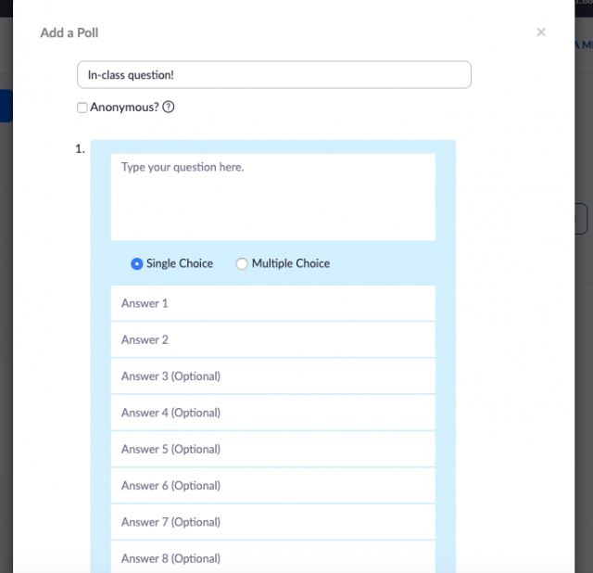
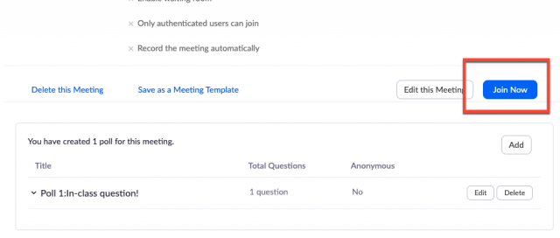
Zoom Polls
Creating an In-Meeting Poll:
  After your have created your question, follow the same instructions for launching and sharing a pre-planned poll.
  To get back into the meeting currently running, click Join Now to be directed back.

Slide 44
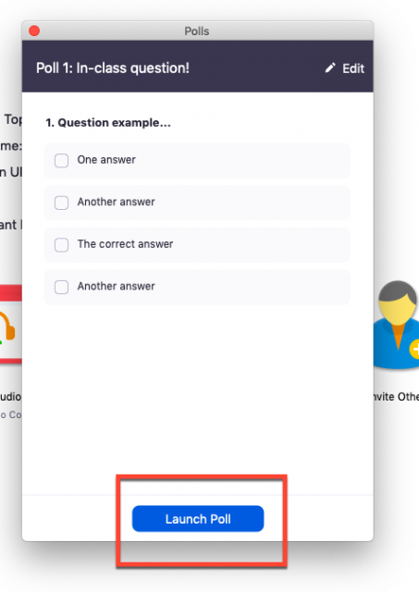

Zoom Polls
Creating an In-Meeting Poll:
  Next, click the polling icon in the bottom toolbar, which should bring up the newly-created question. Click Launch Poll.
  When participants have finish answering, click End Poll.

Slide 45

Zoom Polls
Creating an In-Meeting Poll:
  You will then have the option to Share Results from the poll, or Re-launch the question.

Slide 46


Ending / Leaving a Meeting
Participant: As participants, you can choose to leave a meeting anytime you wish. There are no extra steps involved, and you can simply be done with it once you choose to leave that meeting behind. You’ll see a red ‘Leave’ button at the bottom-right corner.
Host: As a host, first, you’d need to click on the ‘End’ button at the bottom right corner of your screen. This will give you two options: ‘End meeting for all’ and ‘Leave meeting.’ If you wish to leave the meeting but keep it running, you’ll need to assign a host first and then leave.

Slide 47
All the rest…
There are many other facets available on Zoom for both participants and hosts, such as:
  Breakout Rooms
  Adding Alternate Hosts and Multiple Hosts
  Live-streaming meetings
  And more…
Take time and explore Zoom!

Slide 48

Thursday, September 15, 2022 © Connecticut State Grange

